Slide 1
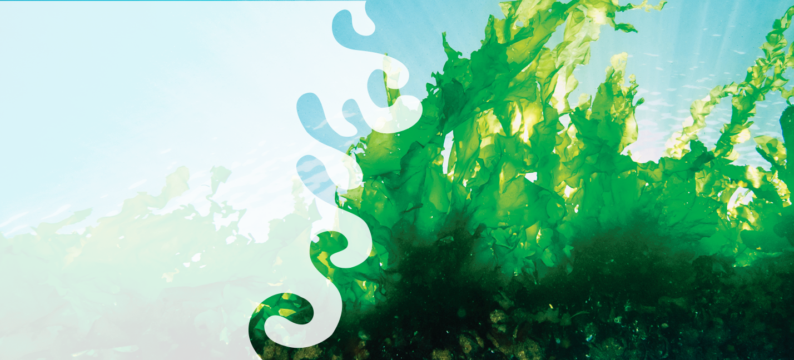





Disrupting the Western food & Health paradigm with Seaweed
QUEENSLAND SEAFOOD MARKETERS SYMPOSIUM 2018
Dr. Pia Winberg
CEO Venus Shell Systems
CEO PhycoHealth
Honorary Fellow
School of Medicine
University of Wollongong
pia@uow.edu.au

Slide 2
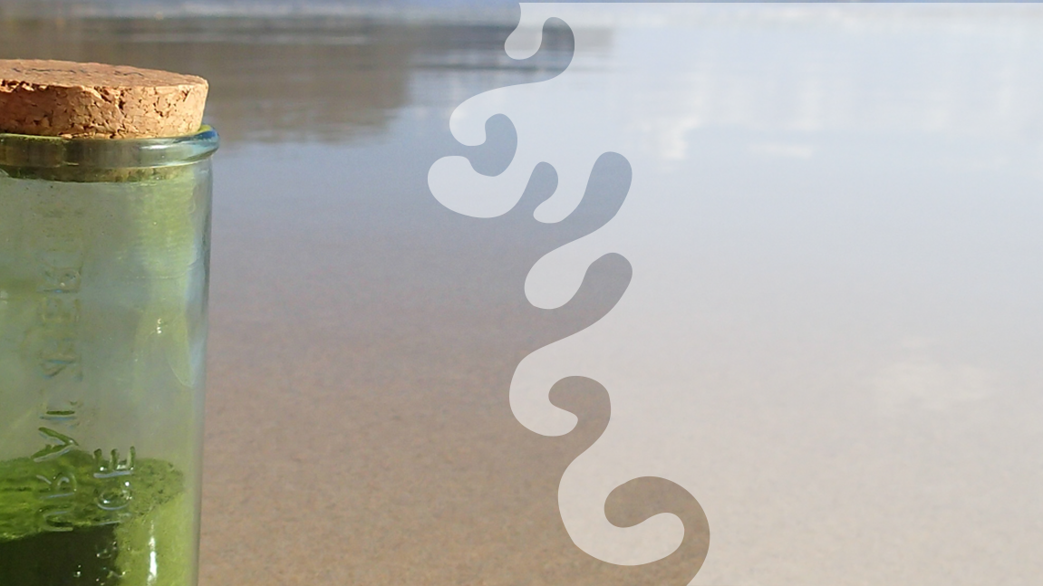
Why Seaweed?
Fastest growing crop
$10B Sustainable
global
Crop
Carbon efficiency opportunity
The customer is excited
But…..
Underexploited resource in the West
Australia has unique opportunity
…. requires education and
effective marketing
Non-binary platform of products
Nutritional
potency
Future Health
Biomatrix
materials

Slide 3
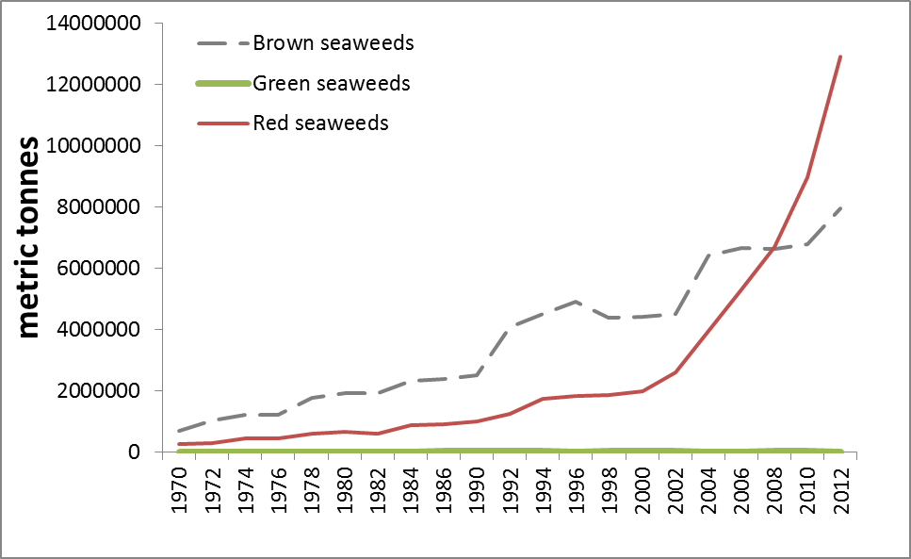
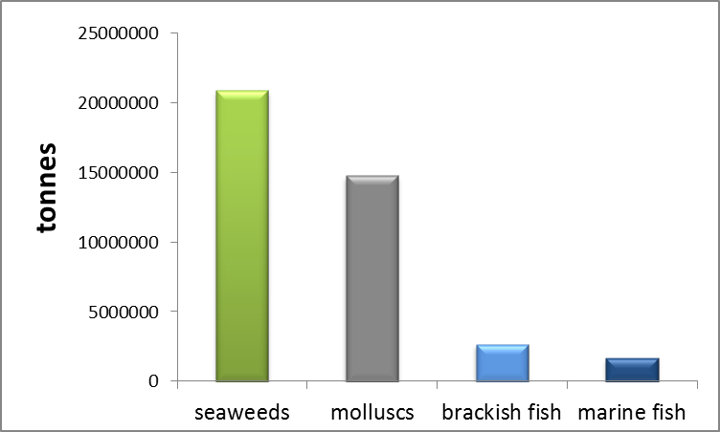
The rise of modern global seaweed crops
A history of seaweed crops
That started in the 1940s:
  Rise of the reds
  Base is brown
  Future is green
Current global farmed seaweed production outweighs other aquaculture production… but it is mostly in Asia and the west is far behind.
Red seaweeds
Global Seaweed
Production
Brown Kelp
1970
1980
2000
2010
2020
2030
The future is
green seaweed

Slide 4
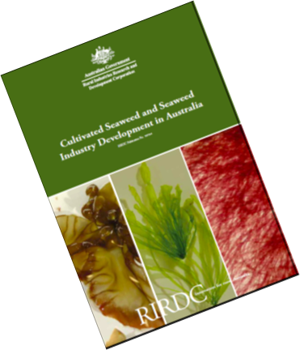
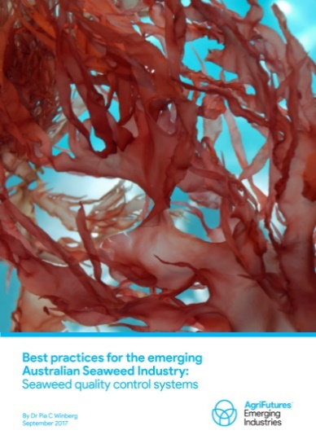

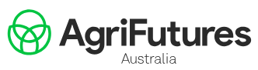
Retrospective strategy for Australia since 2009 –
Australian networking
across engaged
Industry partners
2009
2011
Species &
Nutritional opportunities
2011
2013
Target markets, industry
strategy and coordination
Culture trials with
selected Australian species
Global Status &
Australian opportunity
& position
2017
Best practise towards
standards for
Australian seaweed
2011
All of our RIRDC/AgriFutures research reports since 2009 can be sought at: http://www.agrifutures.com.au/publications-resources/publications/
AND entering the search term “seaweed”

Slide 5
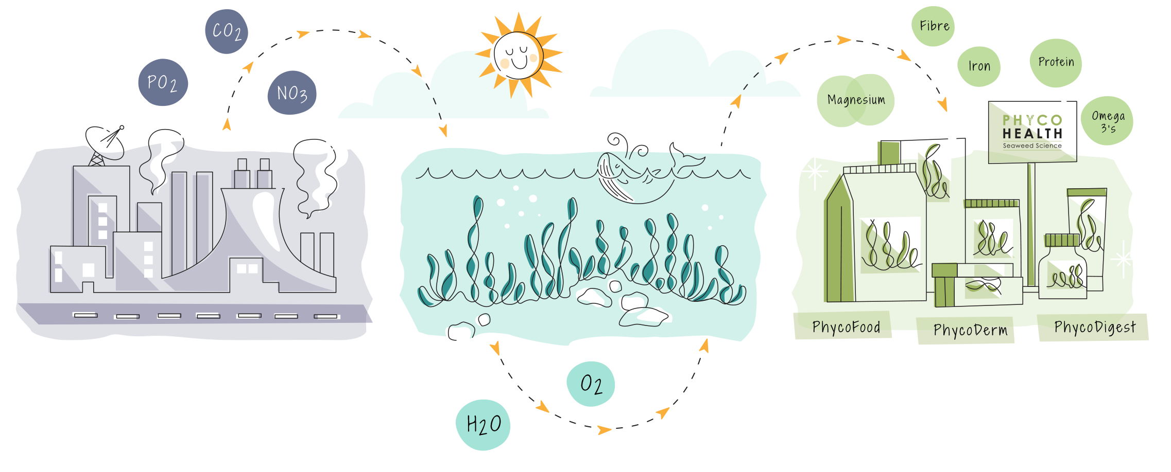
Industrial Ecology System

Slide 6
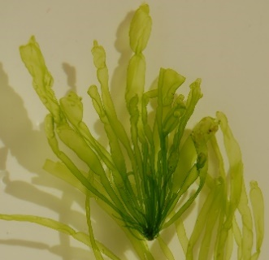
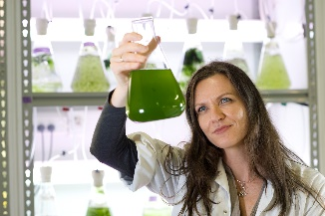
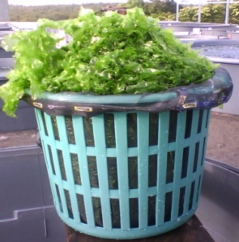
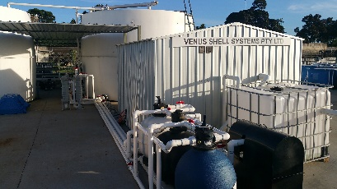
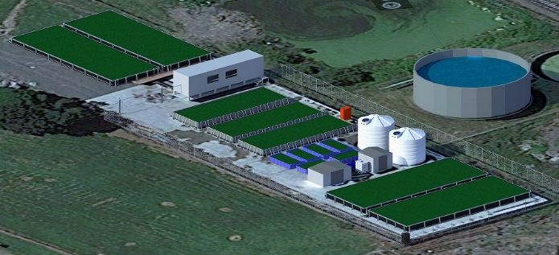
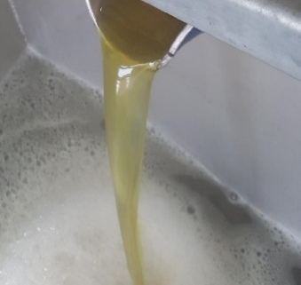
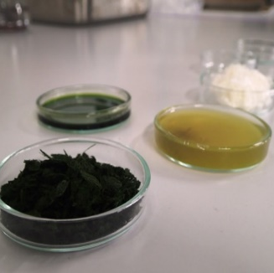
VSS Background – Vertically Integrated
  Genetically
  identified species
Vertically controlled
production of natural molecular ingredients
From sun to bottle
  Controlled Source
  Controlled Production
  100 ton / ha
  production
  Proprietary Extraction
  Diverse
  Fractions
  Food Range
  Skin Range
  Supplements
  Consistent Molecules

Slide 7








But sustainability is not why
people buy seaweed?
Key marketing attribute: health
Second marketing attribute:
novelty and flavour
Pigments
Iodine
Omega-3
Vitamins
GlycoFibre
& Phenolics
Magnesium
& Boron
Iron

Slide 8
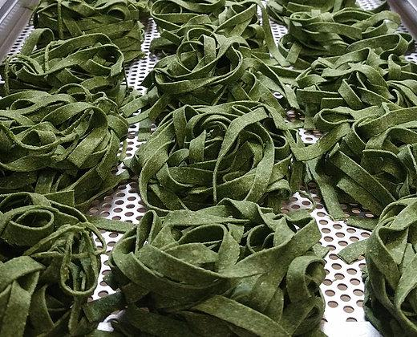
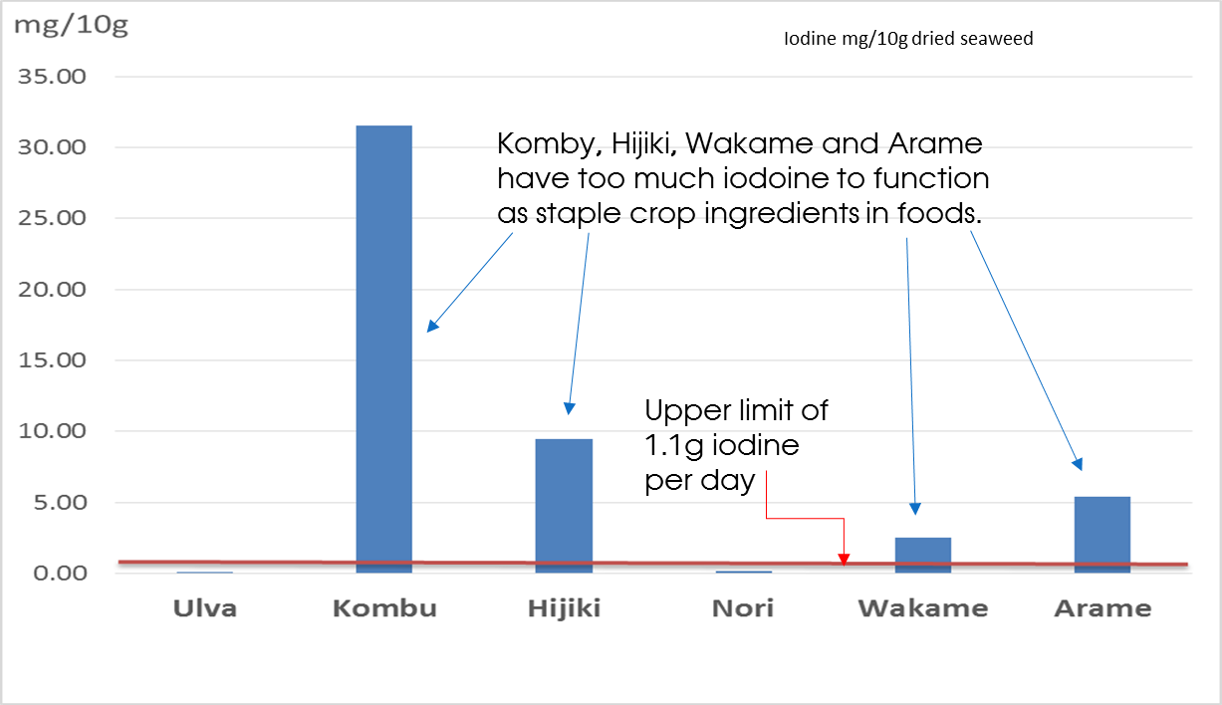


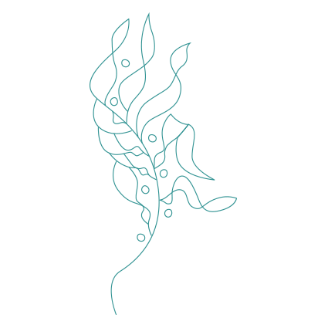
  71% of Iodine RDI
Seaweed Trace Elements and the Irony of Iodine…..
  33% of Magnesium RDI
  65% of your Boron
42% Manganese RDI
40% of iron RDI
….Select your species wisely

Slide 9
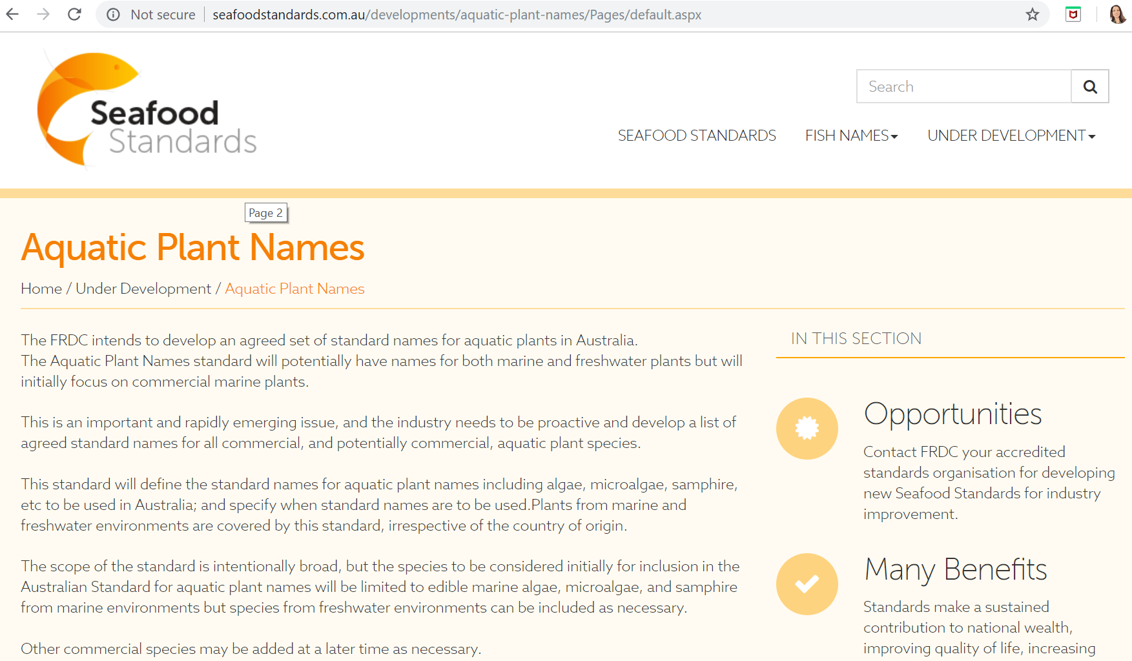
Seaweed ain’t seaweeds
FRDC supported Fish names program is now introducing seaweed (or aquatic plants) naming standards
Public consultation on this will be happening in the near future, and Australia is one of the leading countries in this way.

Slide 10
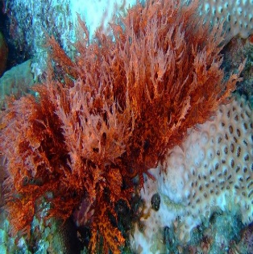

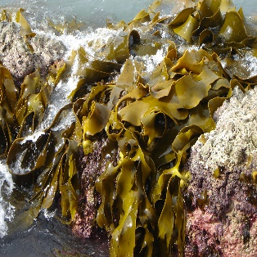
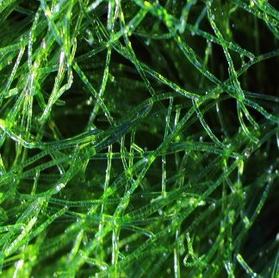
SeaFibre diversity in seaweeds – different seaweeds are different
Polysaccharide categories |  | repeating units
Extracellular matrix | carageenans (galactans) cellulose mannans xylans | glucose, mannose, xylose, galactopyranose, glucuronic acid,
 | alginic acid fucoidan | fucose, uronic acids, xylose, glucose, galactose, guluronic acids
 | ulvans, cellulose, xyloglucan | rhamnose, glucose, galactose, mannose, xylan, uronic acids (glucuronic & iduronic acids)
RED SEAWEEDS
BROWN SEAWEEDS
GREEN SEAWEEDS
Winberg, P. C., J. H. Fitton, et al. (2014). Controlling seaweed biology, physiology and metabolic traits in production for commercially relevant bio-actives in glycobiology. Advances in Botanical Research. N. Bourgougnon, Elsevier. 71: 221-252.

Slide 11


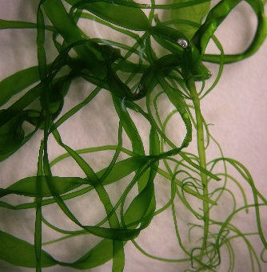
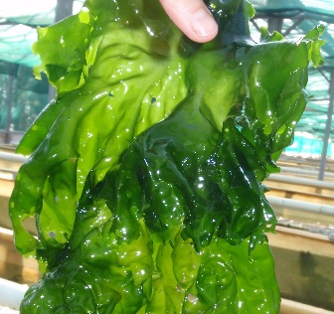
Even closely related species have different SeaFibres

Slide 12
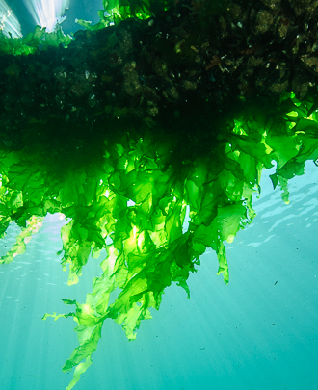
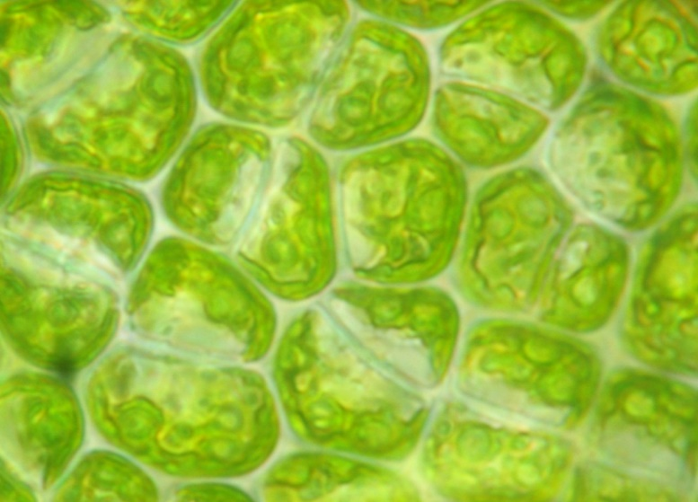

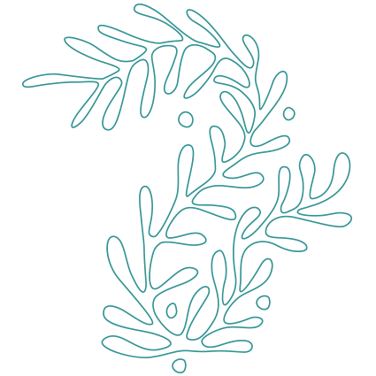
How does seaweed persist like this?
GlycoBiology
Intercellular Matrix
The Glue
The Connector
The mechanical properties
The defence
when other surfaces look like this…..

Slide 13


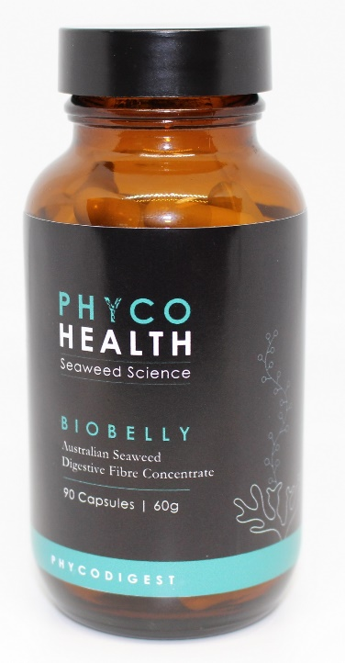
Gut Health & Current Clinical Trials
Reduced Cholesterol
Reduced Inflammation
Shifted gut flora to increase good
bacteria like Bifidobacteria
Dr. Dan Harmelin

Slide 14

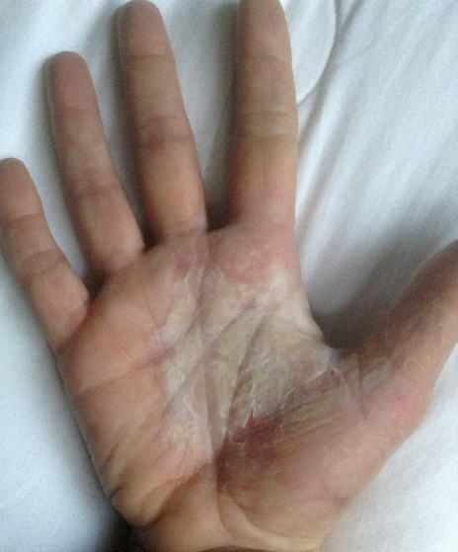
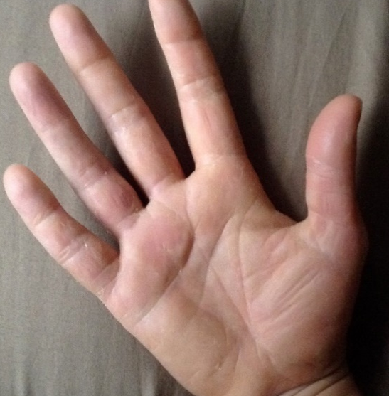
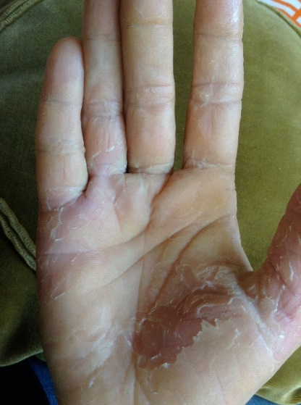
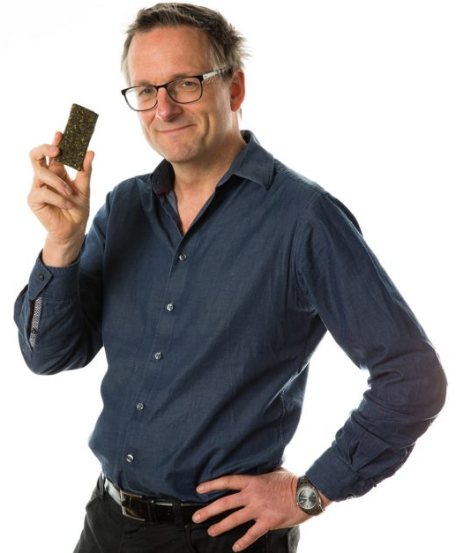
Gut microbiome response
Case Study effect on psoriasis due to reduced
inflammation from the gut – as featured in the Clever Guts Diet
For 2 years
prior to trial
During trial 3 weeks
– bandages off
After trial
– bandages on

Slide 15
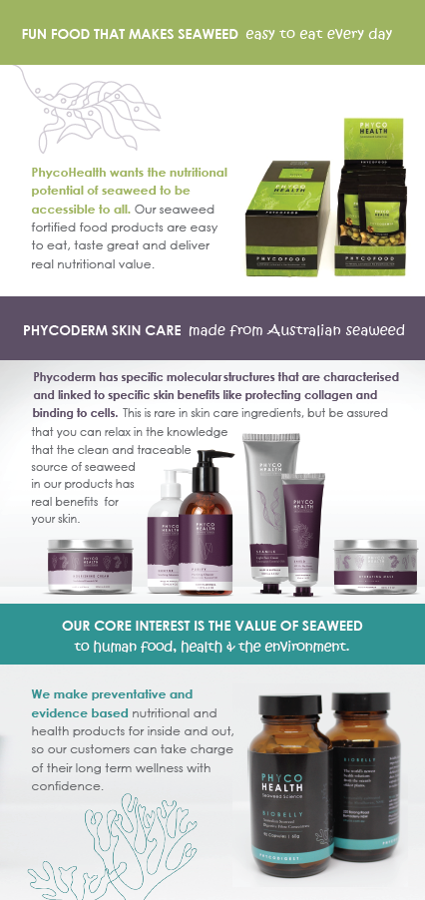
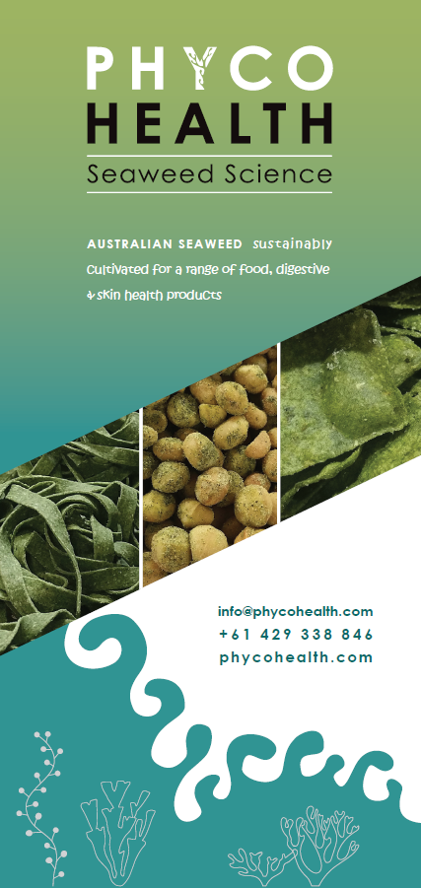
FOOD
SKIN
SUPPLEMENTS

Slide 16
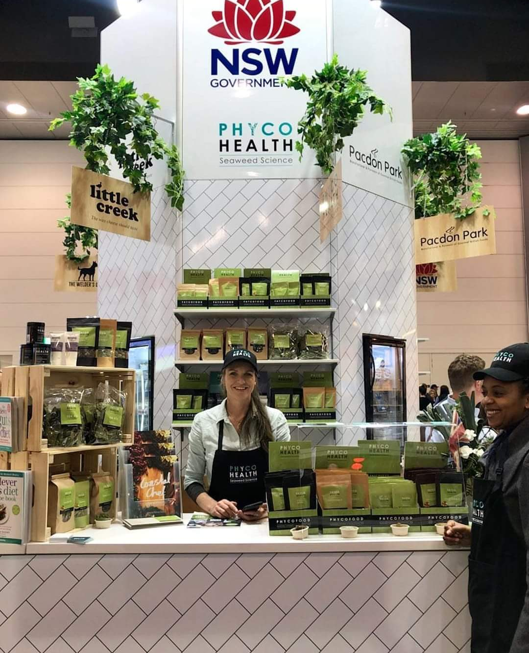
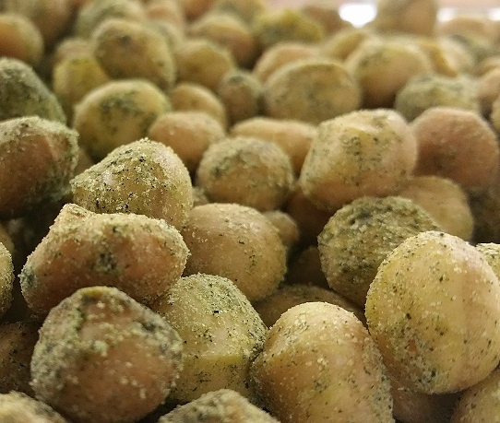
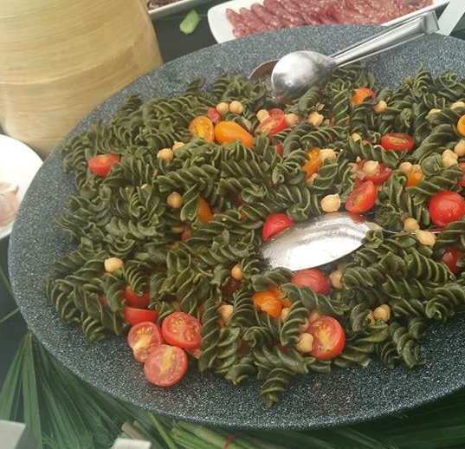
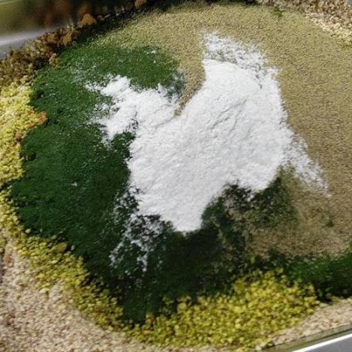
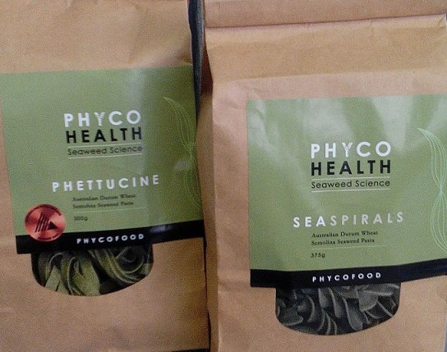
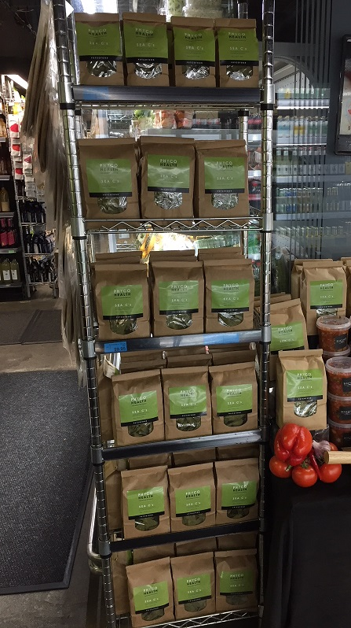
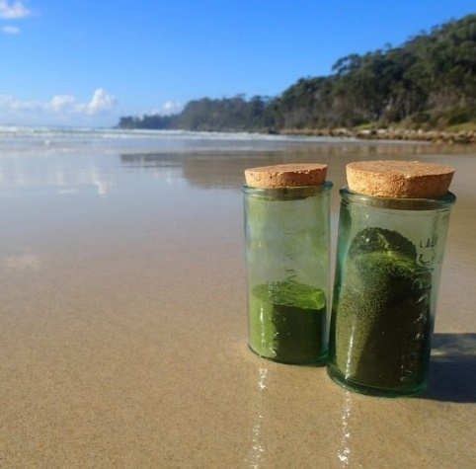
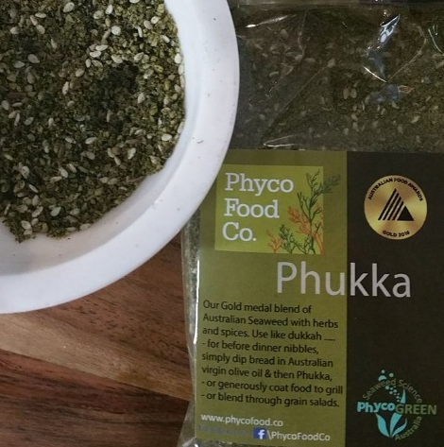
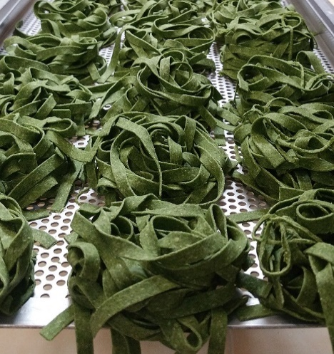
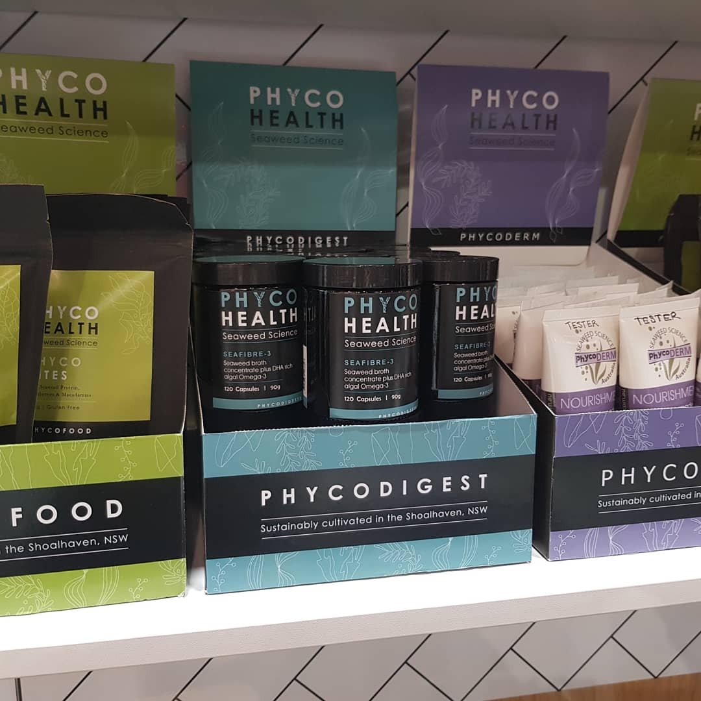


PhycoHealth marketing
16

Slide 17
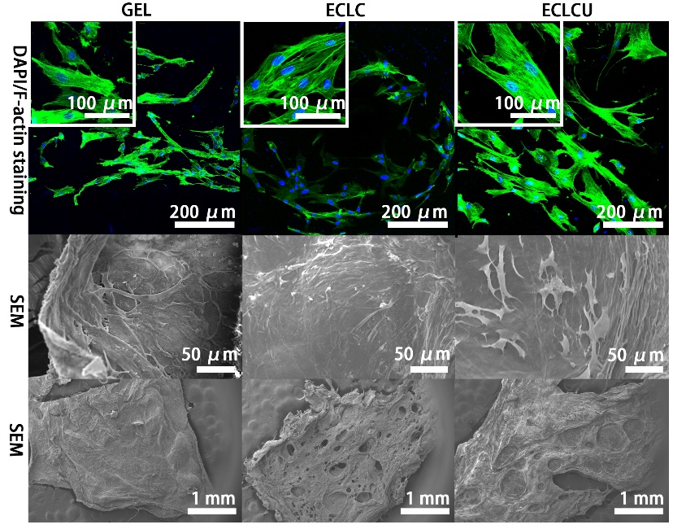
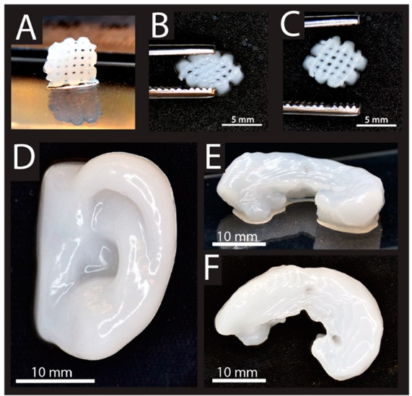
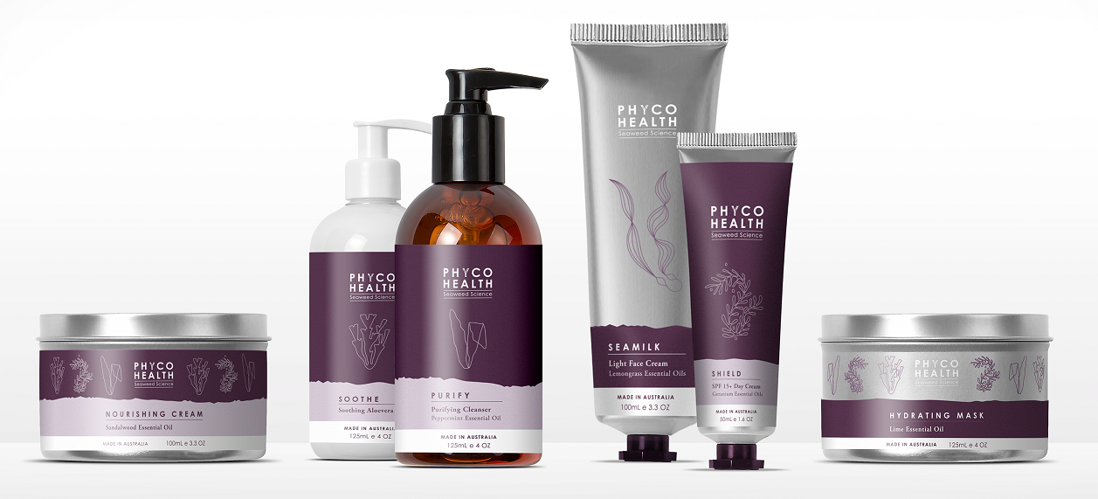
Hot of the press: Seaweed & Skin Scaffolds
The future of tissue regeneration with seaweed
Our green seaweed extracts are very similar to the connective tissue in our own skin.
Allows skin cells to attach and thrive.
Anti-inflammatory action.
Protect and binds collagen.
We are making new therapeutic
products for
wound healing and tissue regeneration,
but also including our seaweed extract
in a new range of
marine skin care

Slide 18
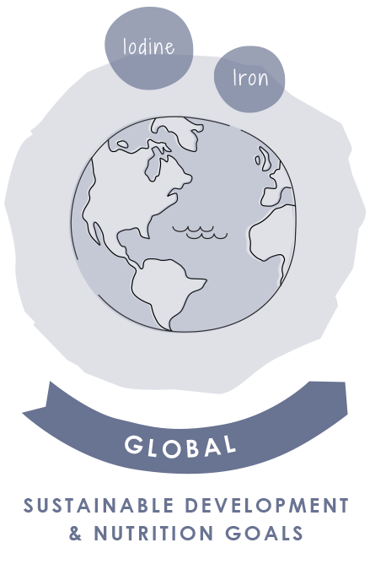
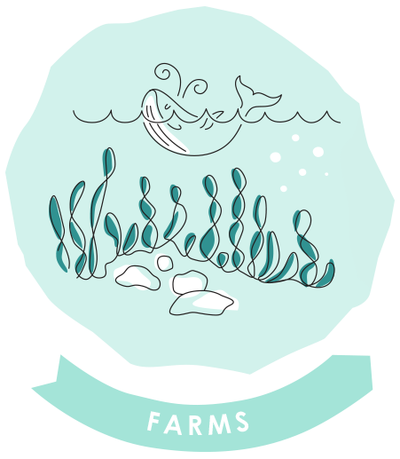
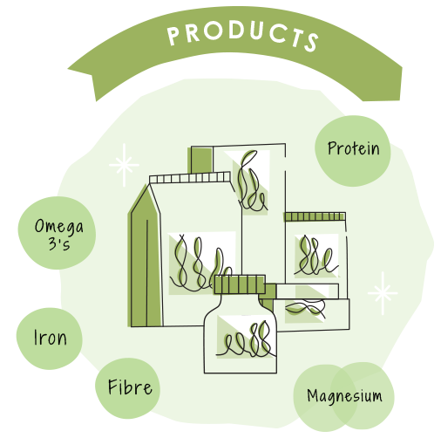


SEAWEED: EXPANDING THE WESTERN SEAFOOD PARADIGM

