Slide 1
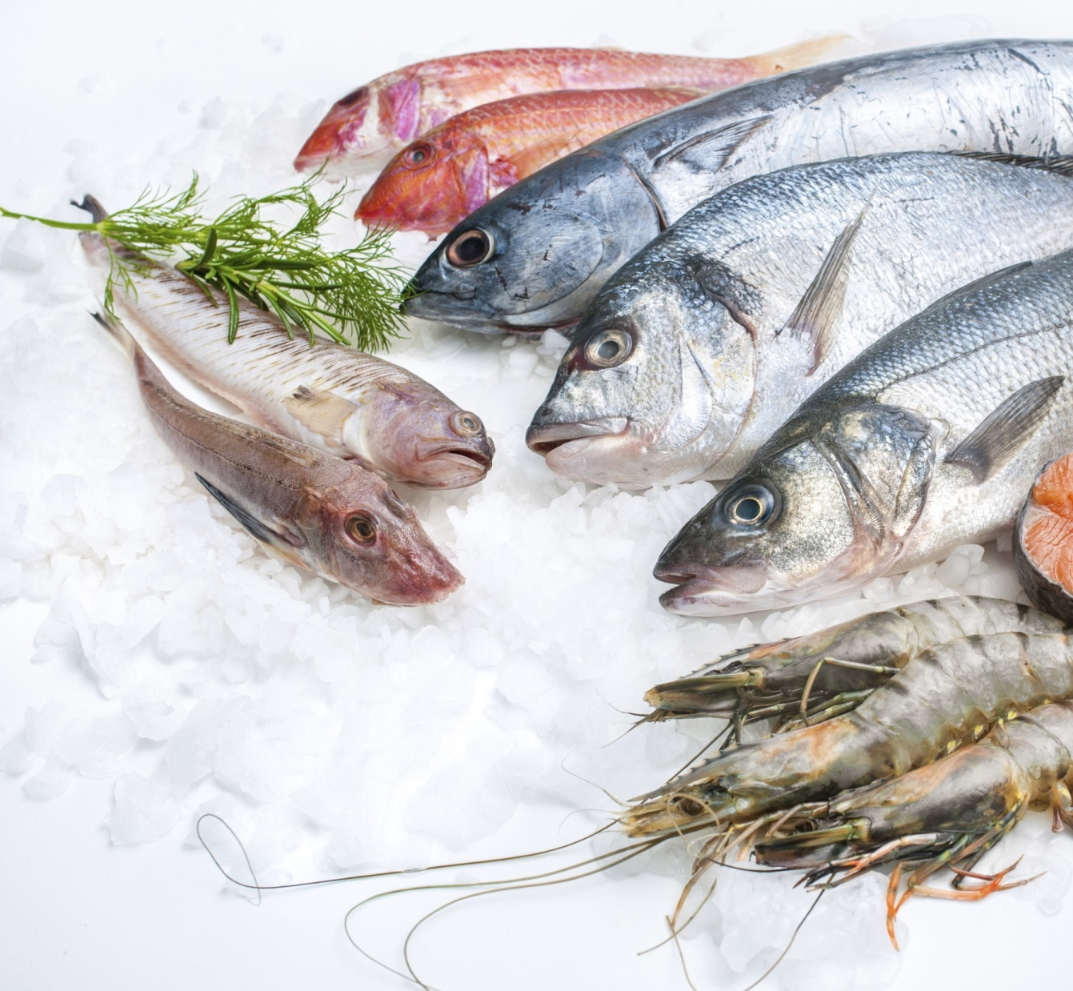
WHAT ARE THEY THINKING?
Inside the hearts and minds of seafood consumers
MICHAEL SPARKS
INTUITIVE SOLUTIONS
National Seafood Marketing Symposium
Queensland Seafood Marketers Association
September 2018

Slide 2
1
get real. the Melbourne Storm game plan.
2
stand in the customer shoes. talk with me not at me.
3
tell me. show me. win.
4
change the conversation.

Slide 3
1
get real. the Melbourne Storm game plan.
Be real
Be clear about the end game and the game plan.
Stay the course.
Show me. Help me.
Engage me.
Empower me. Enable me.
We’ve seen the highs and low of marketing albeit from the sidelines
What we’ve learnt is that. . . .

Slide 4
2
stand in the customer shoes. talk with me not at me.
the buying experience
in late 2016 we spoke to 2,000 adult Australians about their seafood experiences.
these are their experiences. . . .
the preparing & cooking experience
the eating experience

Slide 5
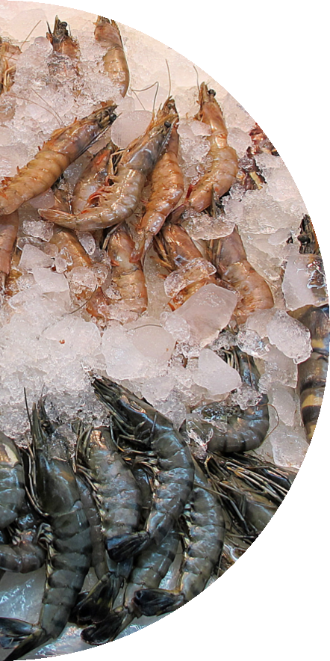
the purchasing experience
there is not a strong level of confidence about buying seafood
Not confident at all - 0
6.9
10 – Very confident
there are five key things that are important to people when they purchase seafood:
 | 1. | Knowing how long it’s been in store
 | 2. | Knowing if the seafood is fresh or has been frozen
 | 3. | Whether the seafood was caught in Australia or overseas
 | 4. | Knowing how long the seafood will last at home
 | 5. | That the seafood bought offers good value for money

Slide 6
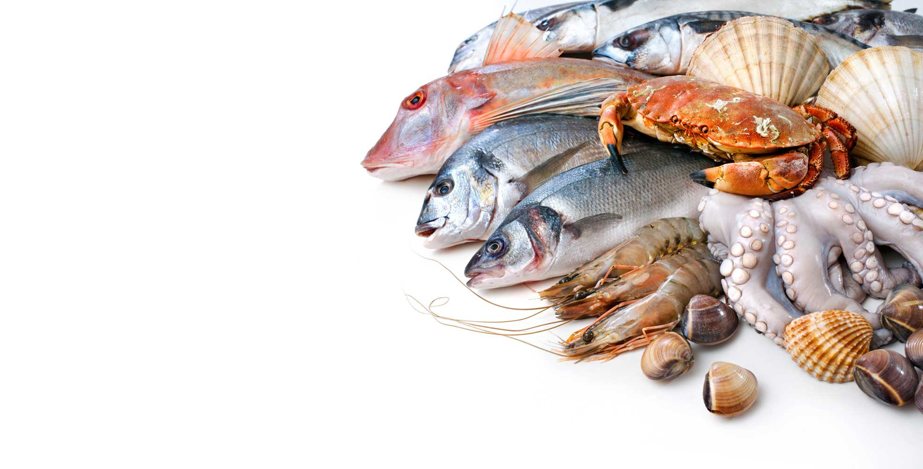
What don’t they like about buying seafood?
25% Not knowing how long ago the seafood was caught | | |
13% Poor range of seafood / don’t have the seafood I want | | |
11% The smell of the seafood is off-putting | | |
8% Inconvenient purchasing experience – the market is too far away, it’s crowded and it’s hard to find parking | | |
8% I don’t know where the seafood was caught

Slide 7
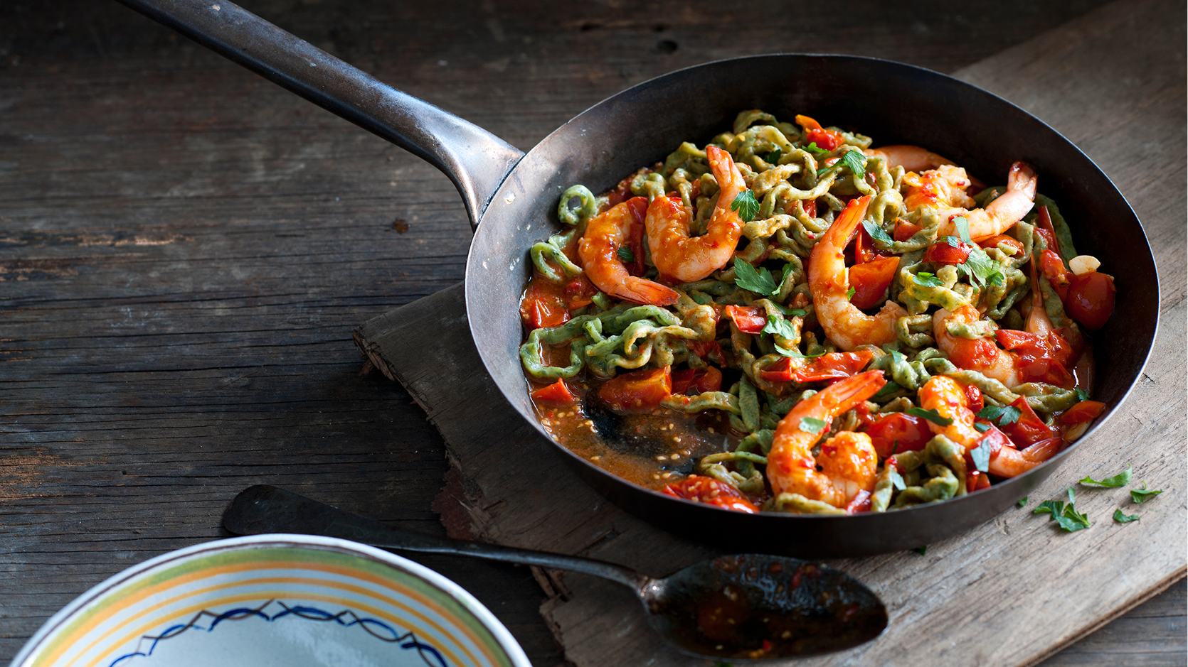
the take aways. . . .
don’t be too smart
| | |
don’t over-engineer the message
| | |
think like a consumer
| | |
be clear, consistent and persistent
| | |

Slide 8
3
tell me. show me. win.

Slide 9
hearts & minds community conversations sustainability and the fishing industry
in early 2016 we spoke to 500 adult Australians about sustainability and the fishing industry
this is some of what they told us. . . .

Slide 10
consumers interpret sustainability with many different lenses
We asked consumers to explain what sustainability meant for them.
15 different description clusters
4 primary description motivators
Enforcement of laws and regulations
Replenishing fish stocks
Protecting and maintaining the health of the environment
Protecting endangered species
Protecting against overfishing of any species
Protecting against overfishing of any area
Making sure we have the best fishing practices (how fish are caught/harvested)
Use of fish farming to alleviate the demand on wild caught seafood
Guarding against catch of non-target species
Sustainability
Provides seafood that is safe to eat
Improving the health of the fish
Ensuring the quality of seafood
Making sure fish remain good for you
Certifying commercial fishing operations
Ensuring the areas fish are caught from are certified to be sustainable

Slide 11
little consensus on what they think it means
This is the best phrase that describes sustainability – Top 7
so what exactly are we trying to achieve?

Slide 12
the take aways. . . .
time to shape the discussion?
| | |
sustainability or trust | resilience?
| | |
focus and targeted
| | |
all in – a whole of industry agenda
| | |

Slide 13
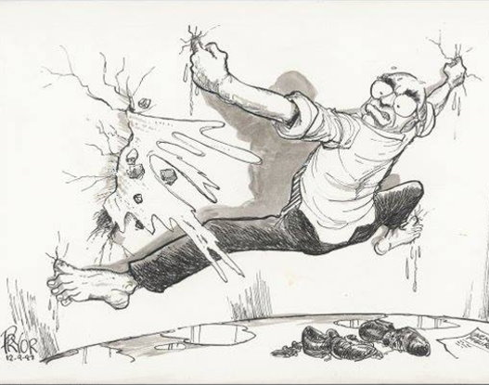
4
change the conversation.
seafood
marketer

Slide 14
sustainability: what they are reporting
Do they believe Australia’s fishing industry is sustainable?
% that believe industry is sustainable or confident that it can be
% that think the industry currently is sustainable
% that are hopeful and confident it can be sustainable
59%
36%
23%
Believe Australia’s fishing industry is sustainable – over time

Slide 15
not all the same
The industry is sustainable
Those who are really interested/aware of the Aus fishing industry, or aware of work industry/Govt is doing to improve sustainability
% that believe industry is sustainable or confident that it can be
ENGAGED
21% (n = 316)
80%
Those not “Engaged” and have either fished once or more in past 12 months, or eaten fresh seafood at least once a month over past 12 months
% that believe industry is sustainable or confident that it can be
CONNECTED
58% (n = 874)
57%
% that believe industry is sustainable or confident that it can be
Those who are not “Engaged”
or “Connected” as defined above
NOT ENGAGED
21% (n = 318)
44%

Slide 16
some clues to the future?
Agreement that certified (i.e. MSC, ASC and Friend of the Sea) gives you confidence that the seafood is sustainable
0
Strongly
disagree
7.9
10
Strongly
agree

Slide 17
the take aways. . . .
chasing the right target?
| | |
fish where the fish are
| | |
use other levers (any levers)
| | |
be clear, consistent and persistent
| | |

Slide 18
WHAT ARE THEY THINKING?
Inside the hearts and minds of seafood consumers
MICHAEL SPARKS
INTUITIVE SOLUTIONS
National Seafood Marketing Symposium
Queensland Seafood Marketers Association
September 2018

