Slide 1
Engage, Promote & Thrive
West Coast Estuarine (Peel Harvey Fishery)
Fresh. Local. Sustainable.

Slide 2
The MLFA – Strength in Unity

Slide 3
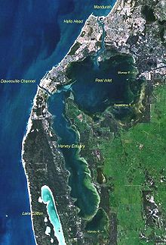
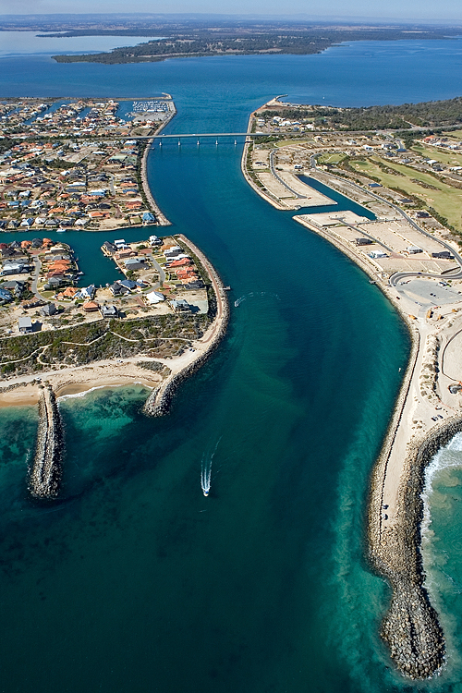
Peel Harvey Estuary & Dawesville Cut (2.5km by 200m @ 6m depth)

Slide 4
3 Canneries: 1880’s Peak production 2,000 tins/day

Slide 5
Sorting catch – circa 1920 approx. 150 fishers

Slide 6
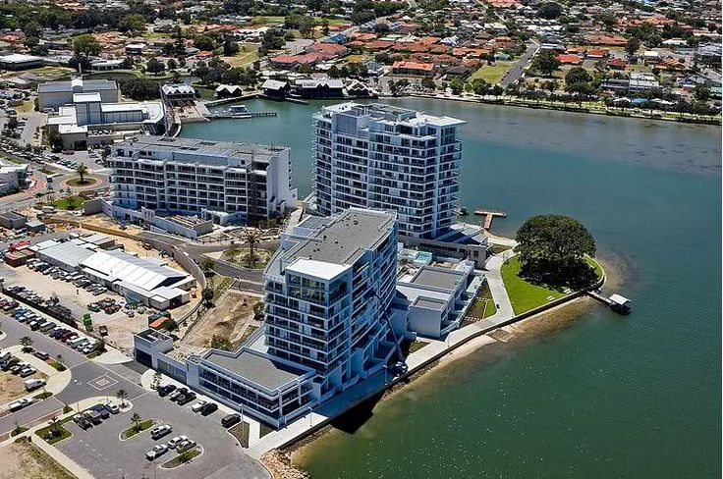
Sea Change
WA's smallest region geographically, however Mandurah is the second fastest growing regional city in Australia.
(Source: DoT, MCC & PDC)
Year | Mandurah Population | Registered Boats
1954 | 1,700
1960 | Mini boom
1981 | 13,500 | 450
2001 | 49,000 | 6,600
2014 | 82,700 | 11,000
2026 | Forecast 139,000

Slide 7
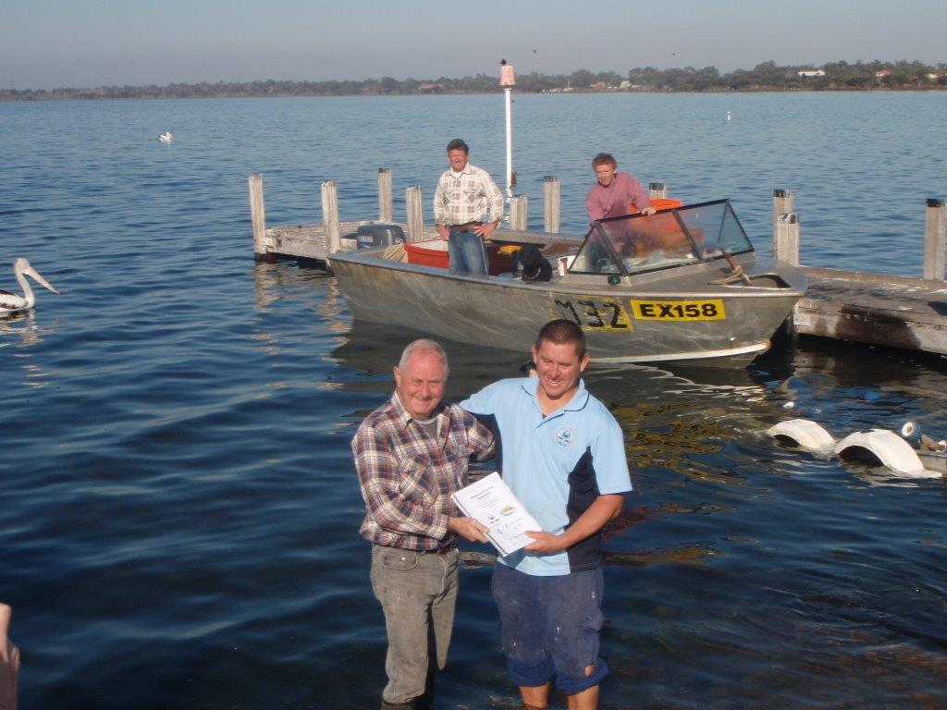
Building Social Licence To Operate
Memberships
Seafood donations
Mandurah CrabFest
Resource Sharing Agreement
Youth Intervention Program
Unity amongst stakeholders
Improving community communication
Environmental Management System (EMS)
State and National award nominations
Marine Stewardship Council (MSC)

Slide 8
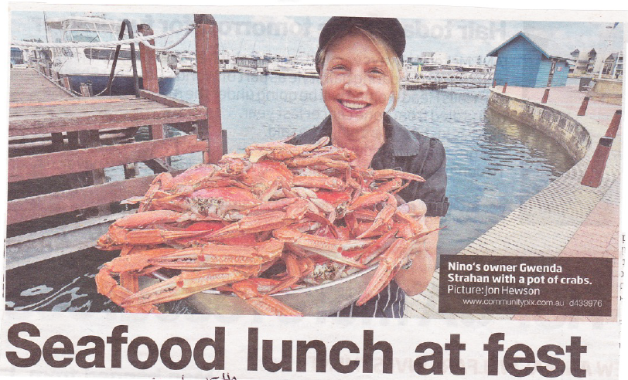
Channel 7 CrabFest
https://youtu.be/JrDUGa4mPHs

Slide 9
Inaugural Cottesloe Crab Broil
John Sharland (Endeavour Foods), Rob Broadfield (West Australian newspaper Food Editor) & Damien

Slide 11
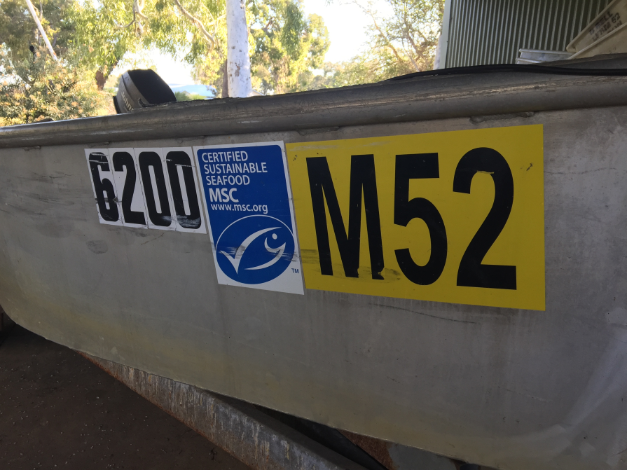
Why engage MSC?
50% of consumers are unaware of fisheries management regime
Community does not believe peak industry body, government departments, industry, only proven independent scientists.
Gold Label 3rd party, independent certification with increasing awareness: 100 Coles stores in WA with 25-31% of seafood consumers confirming recognition

Slide 12
Building the Good News Story

Slide 13
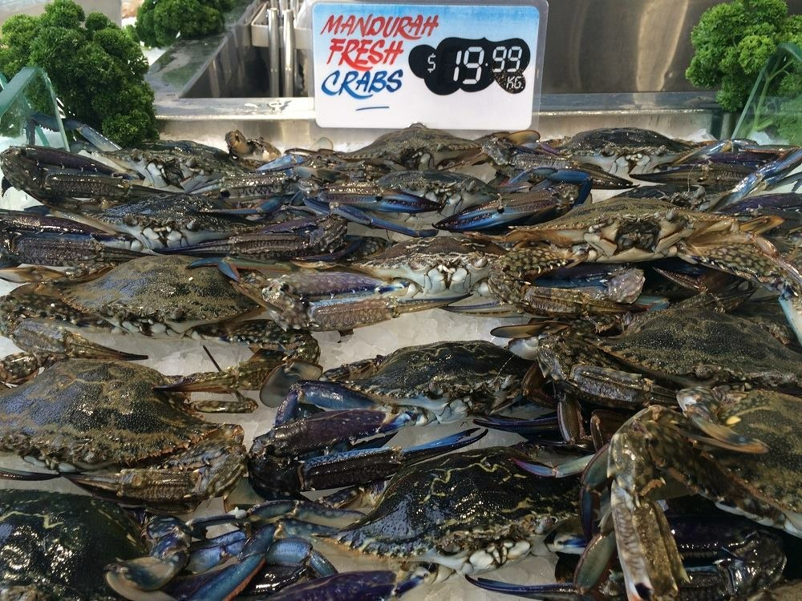
Provence Based Marketing

Slide 14
Mullet is NOT Bait!!
Change of fishers attitude - quality over quantity : Catch less increase quality/return
Consequently, gradually change the consumers perception.
CrabFest Smoked and Sashimi Mullet
Boat Ramp Giveaways
Working with chefs
Mandurah Cruises – Chinese based eco-tourism
Perth Royal Show

Slide 15
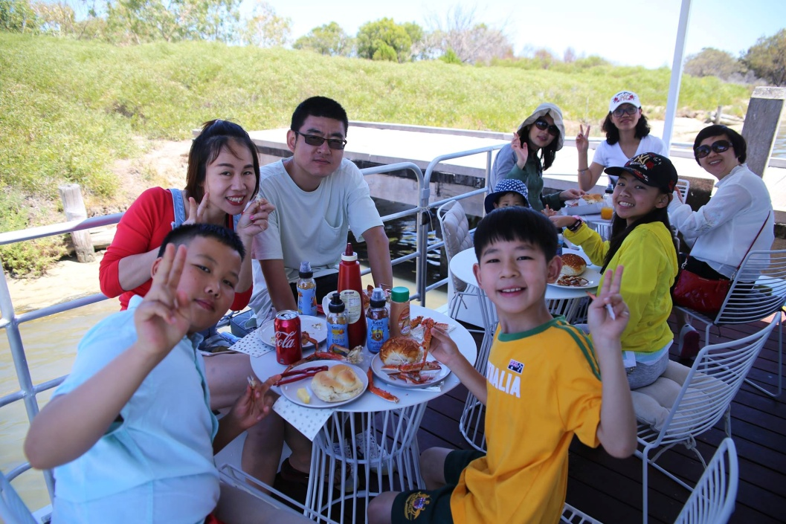
Mandurah Eco – Crab Tour
https://www.mandurahcruises.com.au/cruises-and-tours/seafood-experiences/catch-eat-crab-tour/

Slide 16
Get the most out of the catch!!!
100% utilisation of catch – whole fish through to crab meat and burley bricks
Working with fish mongers – fish to order
Reduced competition between fellow fishers – communicate on catches and market to our set individual clients (benefit of a strong cohesive Association)

Slide 17
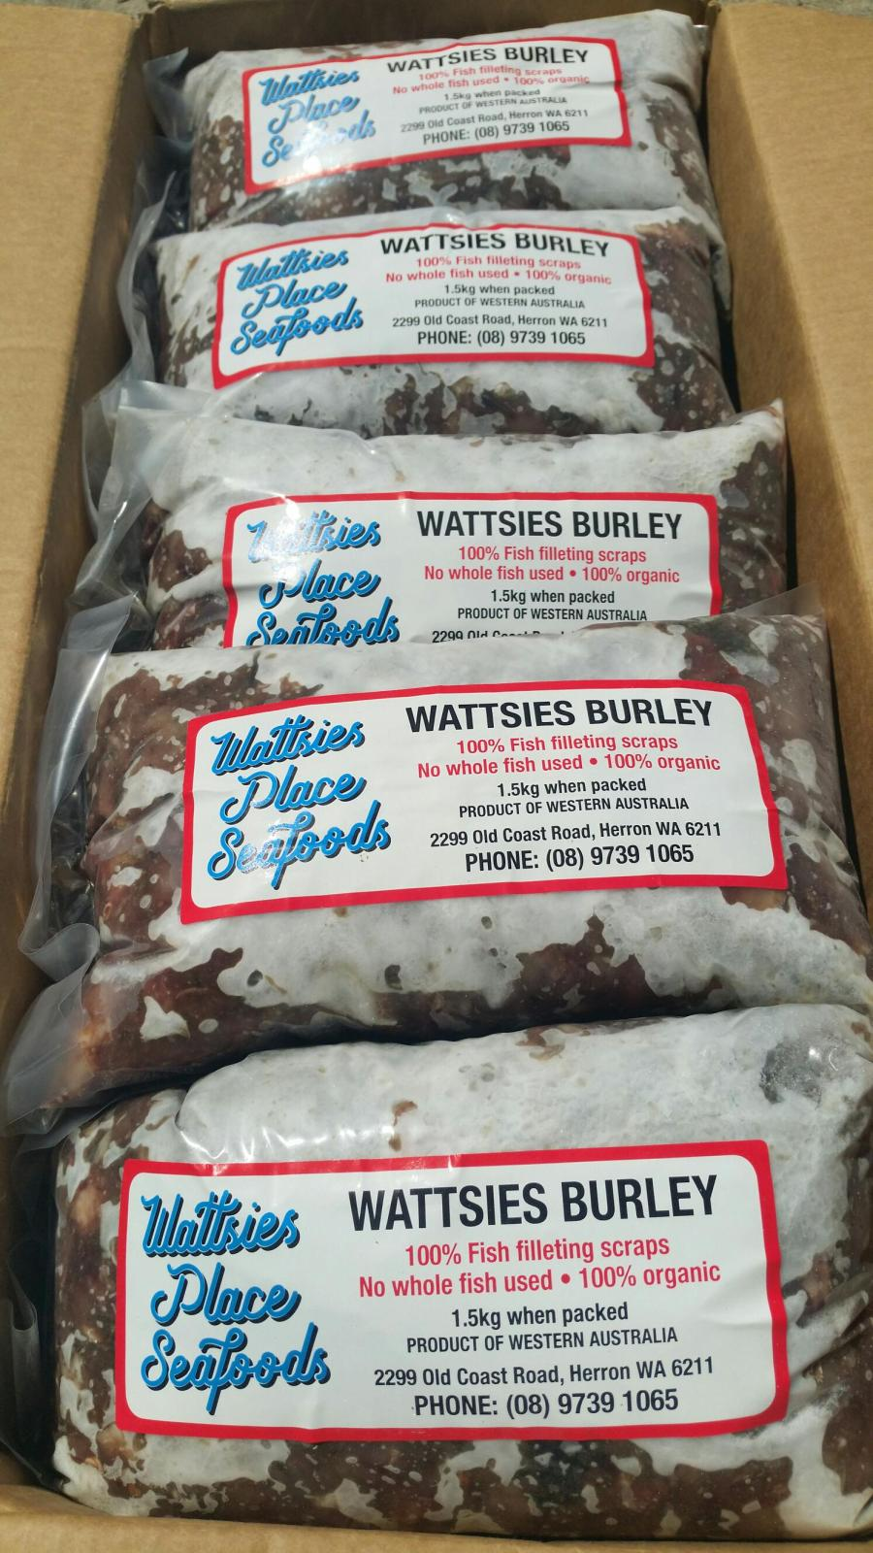
“Staying Ahead of the Curve!”

