Slide 1
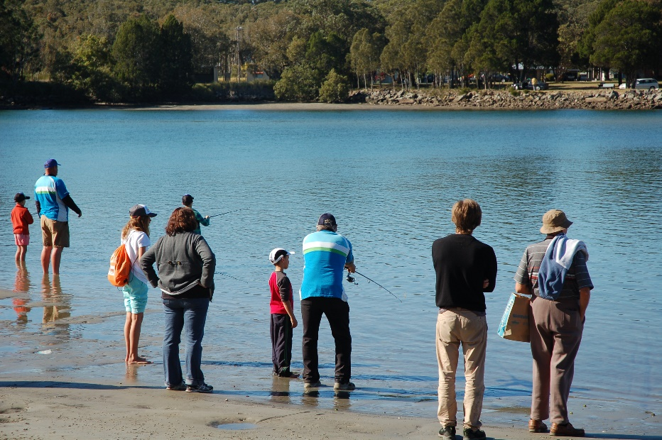
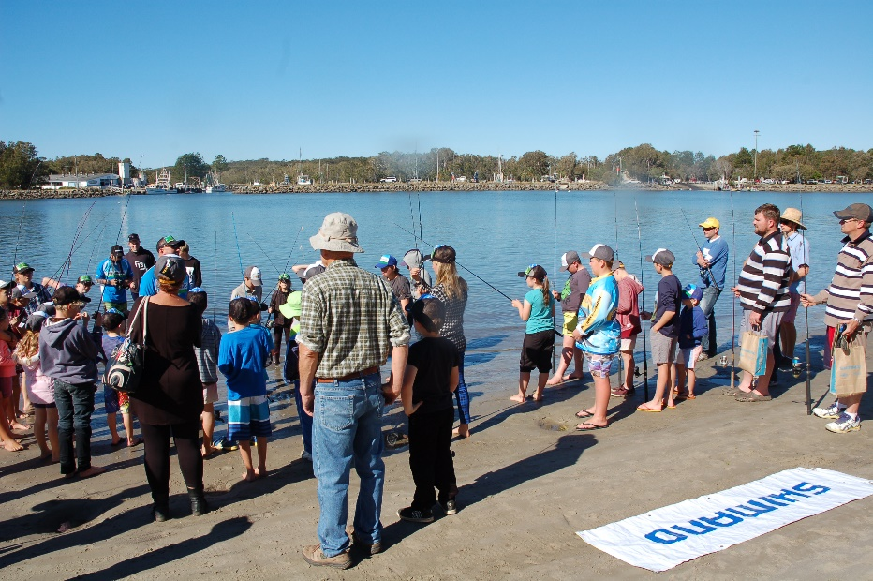
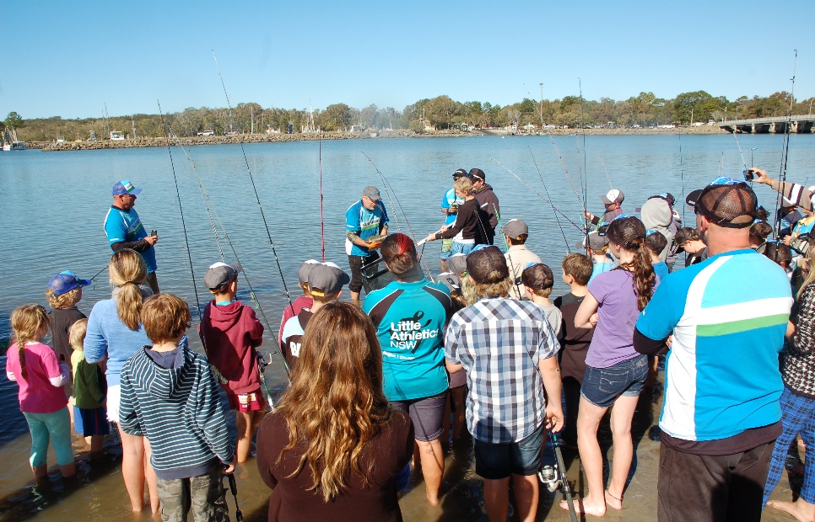
“OUR FISHERY”
Fishing In Schools Program
Colin Tannahill
President
Australian Fishing Trade Association
September 2018
Notes:
Good afternoon.
My name is Colin Tannahill and I thank you in advance for your attention as I present about my vision for “OUR FISHERY” and fishing in schools program.
After attending SEAFOOD INDUSTRIES CONFERENCE LAST YEAR IN SYDNEY and participating in the forum I HAD A VISION to build a generation of Australians with mutual understanding and evaluation of OUR FISHERY.
I have reached out to a few people in and around most of the various circles of fishing including Indigenous, Commercial, Aquaculture and Recreational.
I have no illusions it may need tweaking but please let me explain my VISION as follows.

Slide 2
Objective
To develop and implement a school program that introduces Australian kids to the fishing industry and teaches them all the benefits of the pursuit.
Notes:
Very few children grow up wanting or knowing they can build a career and work in the fishing industry when they have not been exposed it.
The opportunities are not limited to actual fishers or family’s of existing fishers.
The industry needs every facet of education and skills available within our country.
We need accounting,
marketing,
Science, physical on deck, captains and General Managers, retail, wholesale, etc. etc.

Slide 3
Australian Culture
Introduce Australia’s largest outdoor activity into schools.
Educate children on all fishing concepts evenly and unbiased at the grass roots level
Indigenous
Recreational
Commercial
Aquaculture sector
Retail, Wholesale & Media, Seafood & Fishing Tackle
Spear fishing
Inspire, educate and encourage the next generation to get outside and develop interest, unbiased knowledge & career in the fishing industry.
Target A Year Group: High School Grade 7 to 10
Target B Year Group: Primary School Grade 3-6
Notes:
Educate children on all fishing concepts evenly and unbiased from the grass roots level.
This will involve education on the fishing concepts from an
indigenous,
recreational,
commercial perspective, with coverage of the aquaculture sector.
The objective is to educate and encourage the next generation
to get outside and
develop interest or be inspired to build a career
in the fishing industry based on “OUR FISHERY”
Depending on funds we could start in secondary schools year 7-10 and
then aim to buddy down to Primary schools 3-6

Slide 4
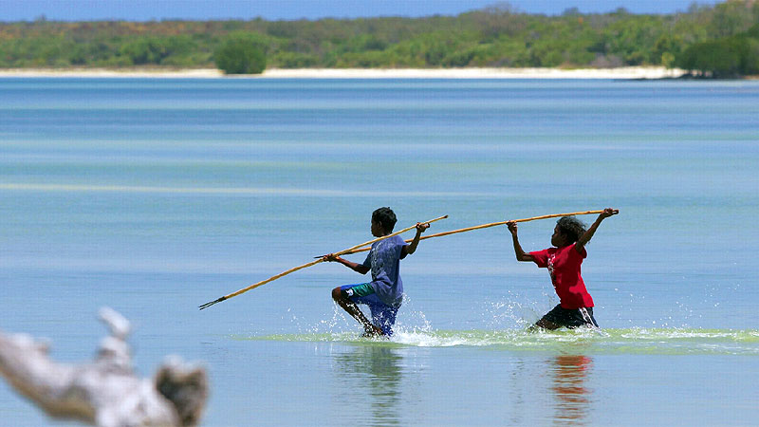
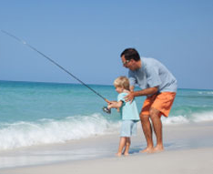
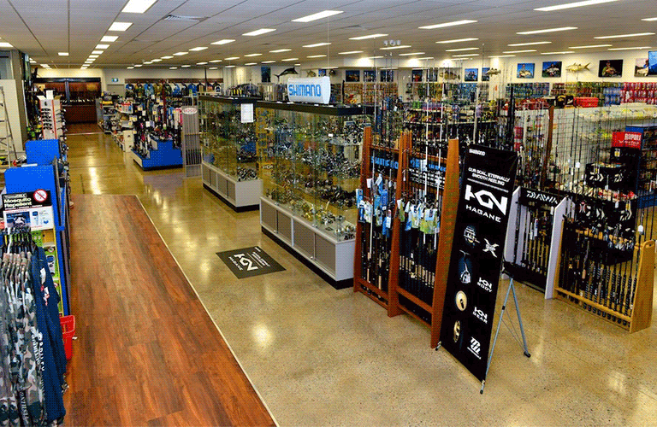
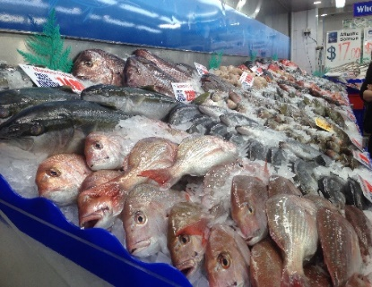
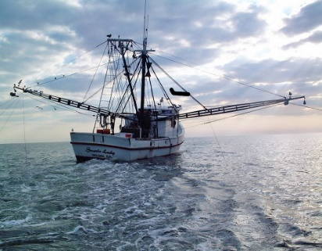
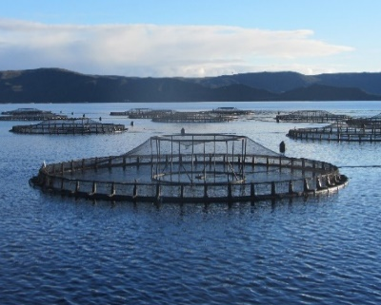
What Sectors Are Represented?
INDIGENOUS
RECREATIONAL FISHING
TACKLE INDUSTRY
SEAFOOD INDUSTRY
COMERCIAL FISHING INDUSTRY
AQUACULTURE
Opportunity to share 40 weeks of schooling between above.
Many learnings and outcomes will be applicable to all or most categories.
Notes:
WHAT SECTORS ARE REPRESENTED?
Indigenous, Recreational, Commercial, Tackle Industry, Seafood Industry, Aquaculture.
There is a Trading element ( Import, Wholesale, retail) of all fishing sectors
with very similar experiences and skill sets.
Currency exchange,
Seasonal Sales, Inventory peaks,
Stock rotation, management,
finance and every day trader business practises.
SEAMANSHIP and on water awareness and peripheral senses ARE
similar for MOST fishing types.
The mental feeling and benefit we boaties or water users get
with or from the awareness of the Marine cycle of tides, moon phases, winds, barometric pressures.
All of these facets of mother nature.
They are mostly the same or have a similar mental health benefit or feeling for all of us no matter what fishing type.
We can have 7 or 8 weeks of each category prepared into an annual syllabus and presented to the next generation of Australians to have them grow up and be educated being aware of OUR FISHERY!

Slide 5
Why All Fishing Sectors?
Providing representation to the diverse range of fishing sectors is key to the development of a holistic educational program that draws upon a range of differing perspectives.
By providing fair representation, the syllabus will be tailored to enrich the learning experience of students and provide the opportunity to understand the cultural, lifestyle and economic significance of fishing.
Inspiring the next generation to take a holistic view opens eyes to the future participation and management of “OUR FISHERY”
AQUACULTURE
Notes:
Why All Fishing Sectors?
By providing fair representation, the syllabus will be tailored
to enrich the learning experience of students and
provide the opportunity to understand the cultural, lifestyle and economic significance of fishing.
Inspiring the next generation
to take a holistic view
opens eyes to the future participation
and management of “OUR FISHERY”
Kids will always gravitate to what appeals to them.
Ideally kids will aspire
to work in one of the sectors
and be educated at a base level on all.

Slide 6
Learning Outcomes
Habitat and Environmental Protection
Fish Farming
Techniques
Indigenous
Significance
Cooking & Preparation
Fish Stock
Sustainability
Outdoor Lifestyle Health Benefits
Hands On Skill
Fish Handling From Water
Fish Species
AQUACULTURE
FISHING
Fishing Theory and Practice
Weather / Meteorology
Boating, Workplace and Sun Safety
Ocean To Plate
Inventory Maintenance
Mental Health
Physical Health
Diet Benefits
Notes:
Learning Outcomes, Benefits, Opportunities.
Potential outcomes are unlimited.
HOW TO LIST? WHERE TO START AND WHERE TO STOP?
So many benefits to inspiring the next generation to be CLOSER TO NATURE.
Many of these such as
MENTAL & PHYSICAL HEALTH, SAFETY,
FISH HANDLING, SUSTAINABILITY, ETC. ETC. are
and will be generic across the various elements of the syllabus.
Ideally as AN EDUCATIONAL ELEMENT EXAMPLE
second stage worksheets CAN BE INCLUDED on
Maths, English, Environment
Including fishing examples LIKE.
SIZE and QUANTITY FOR A BAG LIMIT. Min and max size and weight.
OR
CATCH QUOTA LIKELY YIELD AND QUANTITY TO ACHIEVE
OR
SALES PRICE PER KILOGRAM VERSUS COST OF BUSINESS PER KILOGRAM
WHAT’S THE ROI ON A DAYS FISHING ETC

Slide 7

FOR LIFE Health & Safety
First AID / CPR
  Cuts & lacerations, burns, poisons, breaks.
Dietary requirements
  FISH - Nutrients & protein, lowering risk of disease and illness
  FISH - Low in fats & cholesterol
Overall healthy lifestyle
  Ensuring kids are outdoors
  Reduction in indoor activities, TV and Video Games
Ability to diagnose weather maps & charts
General water safety,
  Rips, tides, wind, boat traffic.
  Basic learn to swim
AQUACULTURE
Notes:
WE SHOULD EDUCATE OUR KIDS ON FIRST AID AT THE SAME TIME TO MAKE OUR FUTURE BOAT SAFETY BETTER?
First AID, only 3% of Australians are trained in any form of FIRST AID compared to the US which has over 70% trained in some for of FIRST AID.
Due to this, FEWER Australians survive cardiac arrest and are able to walk out of hospital.
We should address this as part of the education of “OUR FISHERY”
FISH PROVIDES Dietary benefits include, very minimal fats and cholesterol,
FISH IS an excellent source in quality proteins which compares favorably against both meat and chicken, AS YOU ALL KNOW FISH IS rich in vitamin D,
is an excellent source of important minerals including
iodine, zinc, potassium and phosphorus
and CAN HAVE high levels of omega 3.
Overall WE CAN PROMOTE A healthy lifestyle.

Slide 8
Ongoing Student Benefits
Development and understanding of fishing as a potential hobby, career and lifestyle.
Family bonding opportunities.
Appreciation of fishing's cultural significance.
Encourages positive health and exploration of the outdoors.
Greater appreciation for environmental sustainability.
Instills self-reliance and patience.
Educate next generation of “OUR FISHERY”
Notes:
Ongoing Student Benefits
UNLIMITED BENEFIT LIST OF LIFE SKILLS
For Australia to have educated kids on OUR FISHERY can only be good for the future.
Provide future employment opportunities
Get outdoors and enjoy our great country
Have a greater knowledge of our sustainability and stakeholders in all matters fishing and marine
Educate next generation of “OUR FISHERY”

Slide 9
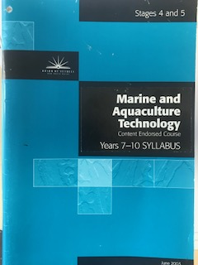

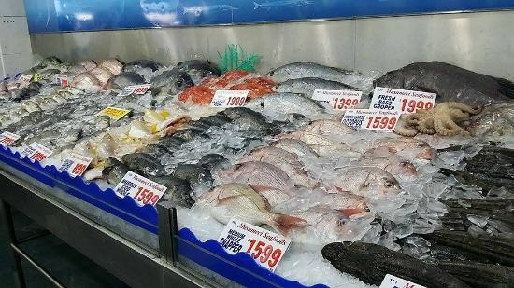
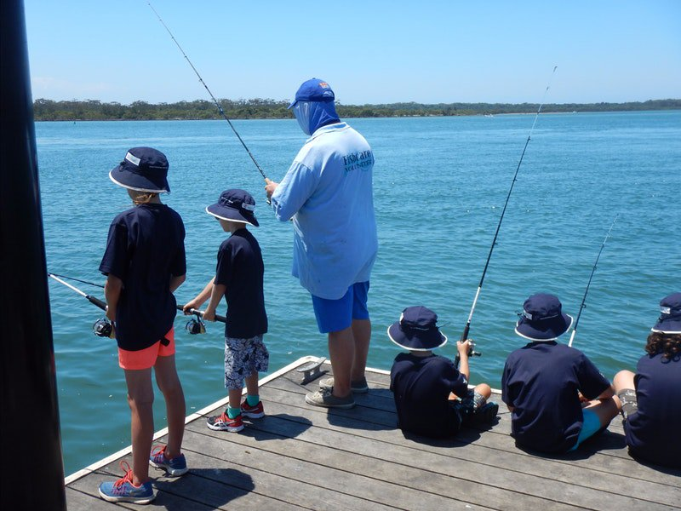

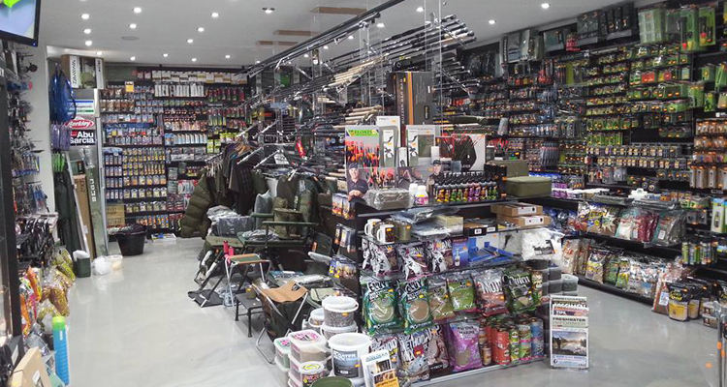
How to facilitate the Learning?
Books
S-TEC Training (Online)
http://na.s-tec.shimano.com/login
AQUACULTURE
ACTIVITY DAYS
Notes:
How to facilitate the Learning?
We can start with books with syllabus prepared class by class for teachers.
We could prepare an online portal
to view video and answer questions and
share future life skills with parents such as know trying or rigging.
Example is at SHIMANO which I am MD of
we have S-TEC which by password customers staff
can access and be trained on all of our items.
We could provide that for kids and they could go home
and practise what they learnt in theory in the class with there parents.
Even on the spot they can go to it in the field.
Also activity field days fishing or to tackle shows, tackle stores,
wharfs, marina’s, aquaculture sights,
facilities like clean seas and retail fish stores or fish markets.
Ideally second stage or in the future we would include a link
between local retailers and local schools.
This means a school activity day may include a visit to
A fish market and or retailer and a local tackle store.

Slide 10
Recreational Fishing
Learning Topics
DRAFT of Recreational Fishing Topics because CT can draft. Need to do for all facets.
Course Topics – Theory and Practical
Fish Species – Identification and Science
Fish Habitat – Marine and Aquatic Environments
Fisheries management & Environmental Sustainability
Employment opportunities in AFTA trade
Code of Conduct Recreational Fishing
Fishing Basics – Practical
- Safe Fishing Practice
- Knot Tying and Casting Basics
- Rigging a Bait and Lure
- Where to Fish
Catch and Release – Why it is encouraged
Caring for, cleaning and cooking your catch
Interactive Learning
Fishing Basics Book
Educational Video Content
Testing based on course learning
Field Trips to local waterways
Class Fishing Competition
Fisheries management
Tides, Weather, Moon
AQUACULTURE
Notes:
I AM HISTORICALLY AND PROUDLY A RECREATIONAL FISHER.
I CAN MAKE SOME BASIS FOR RECREATIONAL ELEMENT EXAMPLE
OF WHAT CAN MAKE UP THE SYLLABUS FOR RECREATIONAL FISHING.
OF COURSE WE WOULD NEED INDUSTRY EXPERTISE
AND LEADERSHIP TO ASSIST THE COMPILATION OF EACH ELEMENT OF THE SYLLABUS
I have access to educators and journalists that can reasonably quickly put together a syllabus for Rec fishing.
We would need to source similar for other elements. Aquaculture, Commercial, Indigenous, Seafood Retail, Safety and Trading.
I will not bore you all with all the detail above as I am sure you have the concept.

Slide 11
POTENTIAL SECOND STAGE & PATHWAY
Recreational Fishing Ideas to expand program
Course Topics – Theory and Practical
Big 4 National Big Fishing Day ( Like Cricket)
Concentrate entry point for fishing
Link schools and kids to local retailers
Link schools and kids to clubs
Links kids to buddy system as much as possible
Buddy provides mateship and togetherness and installs confidence / inspires to go fishing
Mailing List
Link to other suitable industries. Camping, Boating, Outdoor
All trying to change direction of kids from purely electronic to getting outdoor again
Interactive Learning & Pathway
Fisheries studies,
Fisheries regional and national management
Fisheries sustainability and protection
App Fishing
AQUACULTURE
Notes:
Notes on this page can be extensions on previous slides or next stage or pathway for the kids.
These are notes I have received from people like Trevor O’hoy ex Cricket Australia Chairman who has experience in such matters as the kids MILO CRICKET PROGRAM.
It is an example of how we could progress from initial stage to the potential next stages and pathways for the kids to study and work in, in the future.

Slide 12

Shimano Junior Indigenous Guide Program
REAL LIFE INDIGENOUS PATHWAY EXAMPLE HAPPENING NOW
Notes:
REAL LIFE INDIGENOUS PATHWAY EXAMPLE HAPPENING NOW
It shows how we need to diversify for each element.
We have been a part of an educational program in the TIWI ISLANDS FOR the past 8 years
It has morphed from education in school to on water fishing guide experience whilst at school.
The kids are doing this during years 11 and 12.
We have had Antony Guy graduate and get a full time job at Melville Island Fishing Lodge.
We have branched out of Melville Island to other locations.
I will brush through some of the slides following to give you an idea.
I am very proud to announce that we now have members of the SEAFOOD INDUSTRY SPONSORING KIDS WITH US.

Slide 13
Junior Indigenous Panel
Guy Reynolds AO Macquarie Bank
Matthew Haydon AM The Haydon Way
Lachie Green Macquarie Bank
Jenny Reynolds Cattle Rustlers lodge
Craig Copeland Ozfish Australia
Colin Tannahill Shimano Australia
Notes:
Junior Indigenous Panel

Slide 14
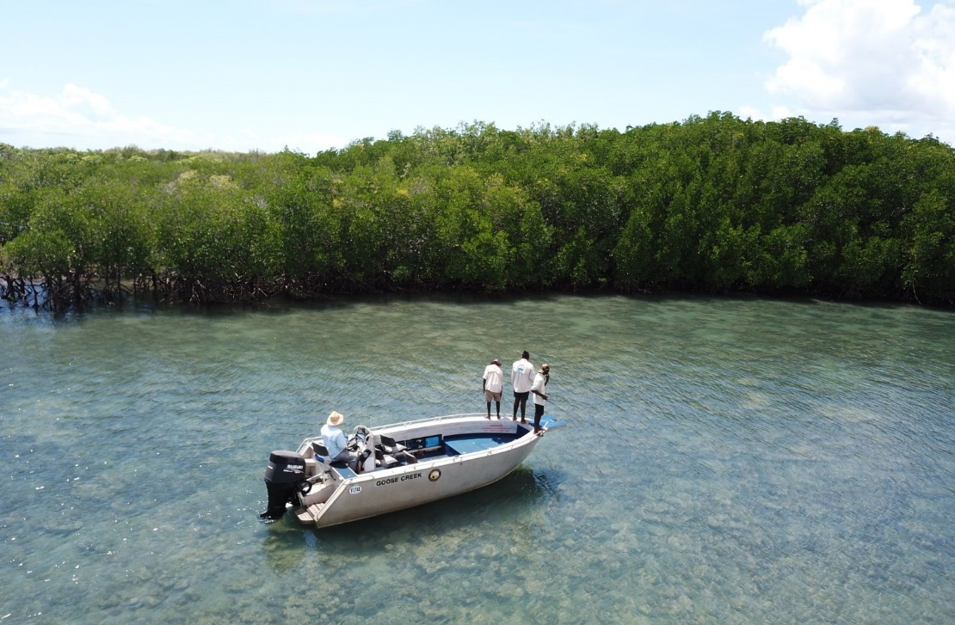
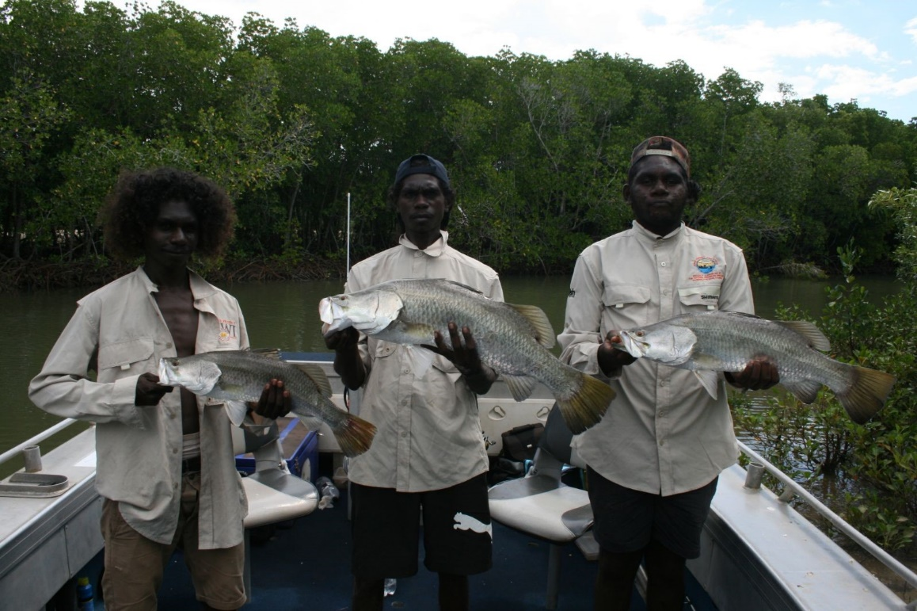
Current Operations
We currently have 15 students working for us over 4 different locations as at June 1st 2018. This number will increase to 30 students within 6 months.
Notes:
Current Operations
We currently have 15 students working for us over 4 different locations as at June 1st 2018. This number will increase to 30 students within 6 months.

Slide 15
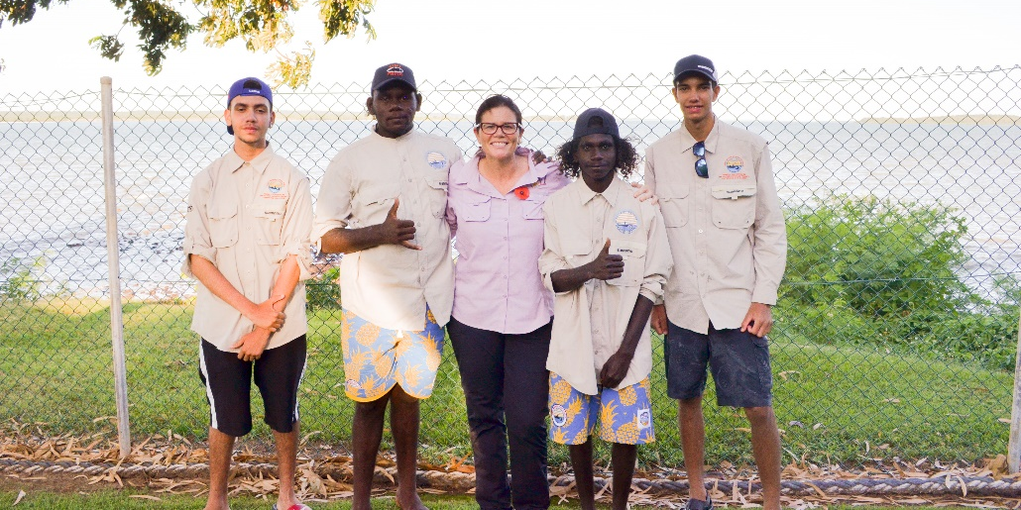
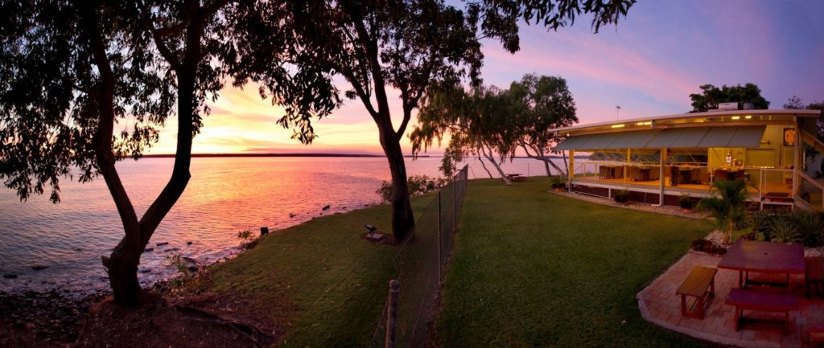
Melville Island Lodge - Tiwi Islands
The Tiwi Islands mentors include Garry Cross, Scott Simpson and Summa Gleeson.
We currently have 9 students rotating through boats under the supervision of Junior Guide graduate Anthony Guy, and the management and senior guides of the Tiwi Islands Adventure lodges.
Anthony Guy has become the first Tiwi Junior Guide graduate to sit and pass his coxswains exam in July 2018
Notes:
WE HAVE 9 KIDS ROTATING ON MELVILLE ISLAND GOING OUT ON FISHING CHARTERS WITH PAYING CUSTOMERS AND BEING PAID FOR THE DAY

Slide 16
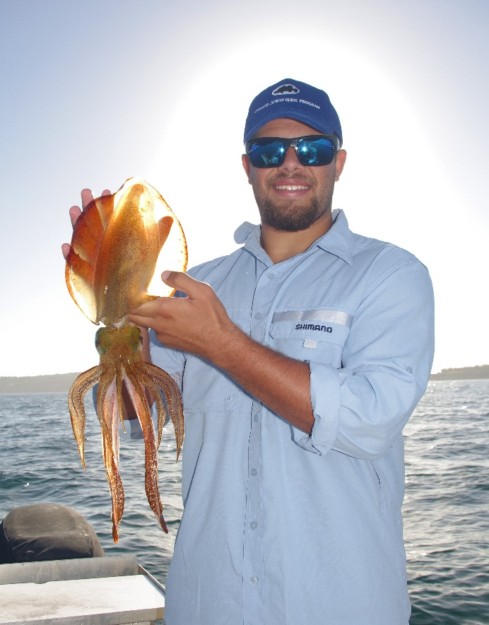
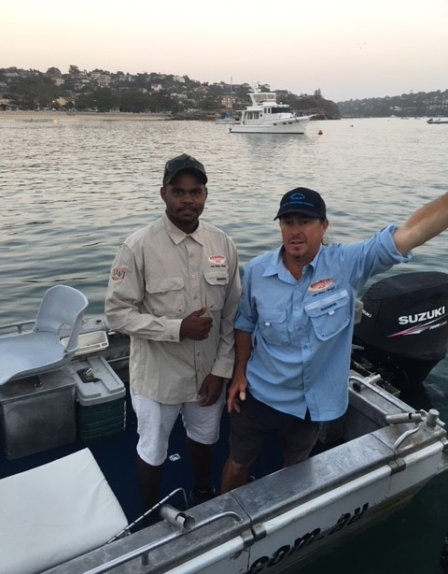
Fish About Tours - Sydney Harbour
Sydney Harbour Mentor - Craig McGill
Our first Sydney based guide Cody Walker has had over half a dozen sessions on the water with Craig,
Cody also shares his time between the Waratahs, Macquarie Bank, and working on mechanical and administrative skills with Shimano.
Notes:
WE HAVE CODY WALKER IN SYDNEY BEING MENTORED BY CRAIG MCGILL AND SPENDING TIME AT MACQUARIE BANK AND SHIMANO IN SYDNEY

Slide 17
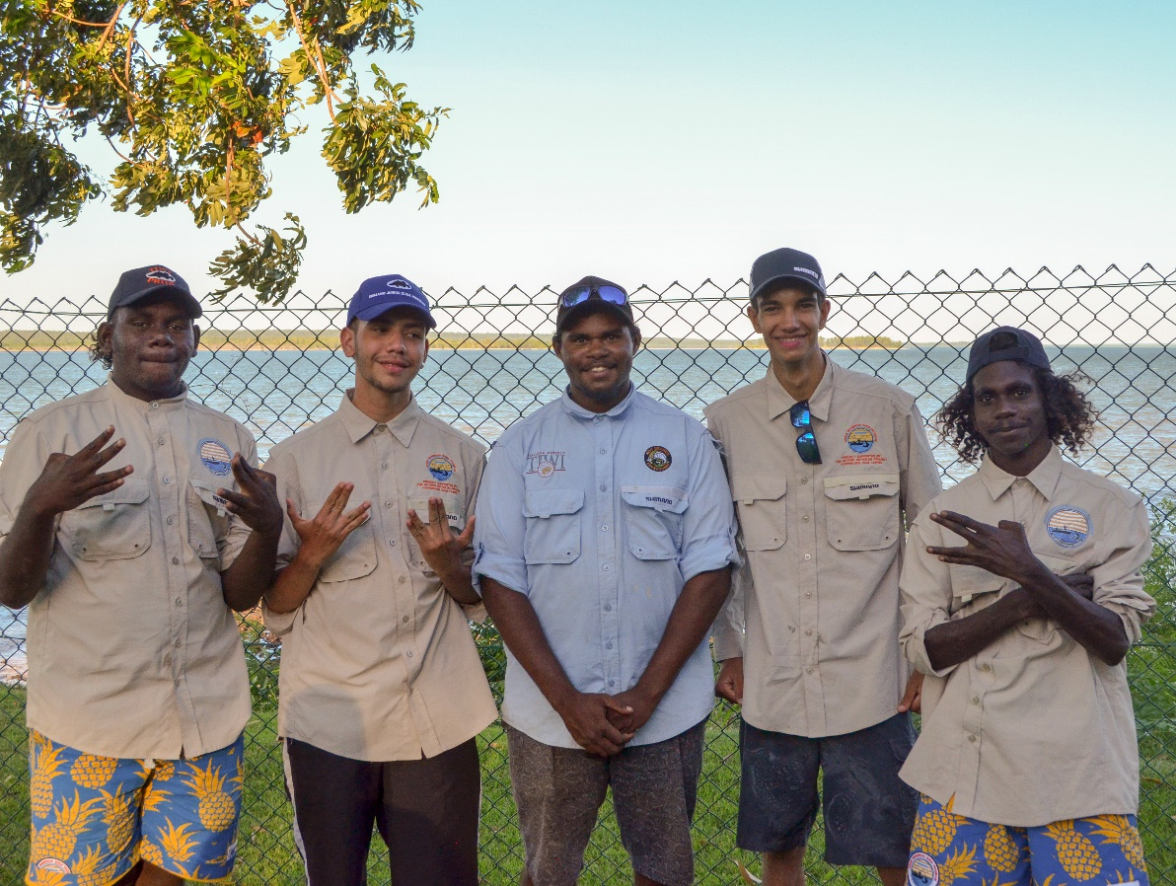
Copperlode Dam - Cairns
Copperlode Damn Mentor – Kim Andersen
Our Cairns training environment at Copperlode Dam was completely decimated by Cyclone Iris.
Their mentor Kim arranged quickly for the Cairns based Junior Guides to travel to the Tiwi’s and work for a period of time until Copperlode dam was up and running again.
This great cross fertilisation of students was a huge success and one we will maintain for many of the students moving forward.
Notes:
WE HAVE TOBIAS AND LAZARUS AS SHIMANO INDIGENOUS JUNIOR GUIDES IN CAIRNS COMPLETING YEAR 12 AND SPENDING ONE DAY A WEEK ON WATER AND BEING MENTORED BY KIM ANDERSON

Slide 18
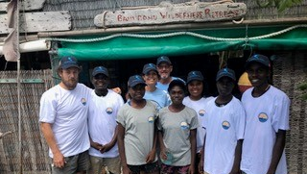
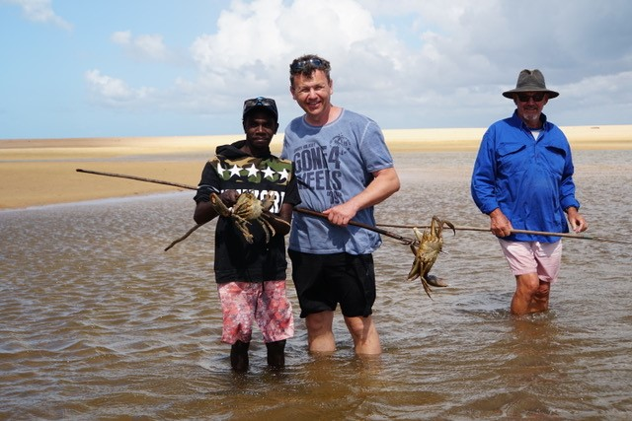
Banu Banu – East Arnhem Land
Banubanu Mentors - Helen Martin and Trevor Hosie
The first Junior Guide, Dylan Gurruwiwi, has already worked three days in his first two weeks, with a second Guide being interviewed currently.
As fishing activities have been restricted after the Cyclone, Helen and Trevor have organised a team of students from East Arnhem High Schools and Dhimurru land management to assist in beach reparations.
Our drive here is not only the employment of East Arnhem children, but the development of a turtle sanctuary on the island.
Numbers of students is expected to increase from 2 in 2018 to 4 in 2019.
Notes:
WE HAVE 2 CHILDREN IN BANU BANU

Slide 19
The Cairns Template
Engaged secondary education with a program driven by the principle at Woree State High School with a student base of 40% indigenous students from across Queensland.
Purpose built Marine Tech campus involving interactive navigation and boating skills, as well as rescue, engine repairs, refrigeration and theory.
On water experience model
- 3 days school,
- 1 day on the job work experience,
- 2 days marine Tafe,
This model will start in February 2019 with 17 students, up from 2 students in 2018
Notes:
NOW CAIRNS HAS A GREAT MODEL WITH A GREAT TAFE AND THE KIDS FROM FNQ ALL CONGREGATING AT WOREE HIGH SCHOOL.
WE HAVE RECENTLY ANNOUNCED THE JUNIOR INDIGENOUS MARINE AND EDUCACTION PROGRAM IN CAIRNS.
MATT HAYDEN AND GUY REYNOLDS DID THE PRESS RELEASE AND I AM VERY PROUD TO CONFIRM AUSTRAL FISHERIES ARE SPONSORING 7 OF THE KIDS IN CAIRNS FROM JANUARY 2019.
MACQUARIE BANK
AUSTRAL
SHIMANO PERSONAL SPONSORS
AUSTRALIAN BUSINESSES AND AUSTRALIANS COMING TOGETHER.

Slide 20
Sponsorship Opportunity
Sponsorship Opportunity exists for Corporate and or Individual sponsorship with the program.
Pod funding of $50,000 pa will secure a dedicated group of 7 kids for 12 months 1 day per week salary.
Pod involvement can be located where the infrastructure is in place to manage the opportunity for the kids.
Schooling, Work placement, Ideally Tafe options.
Individual sponsorship can be at $7,000 per child per annum.
Notes:
I AM NOT TRYING TO SELL SPONSORSHIP HERE.
I AM SHOWING THIS TO CONFIRM
WE ARE ALREADY TRYING TO PROVIDE A PATHWAY FOR THE INDIGENOUS KIDS OF AUSTRALIA IN EDUCATION, MARINE AND FISHING.

Slide 21
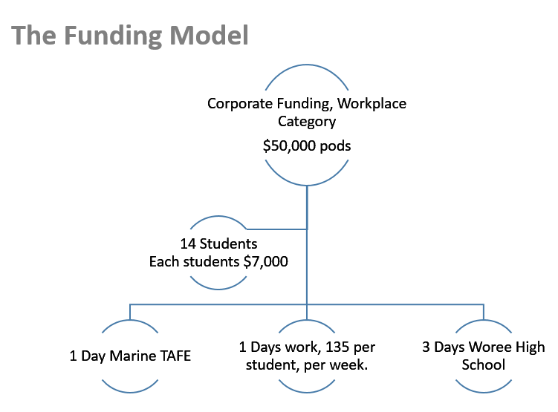
Macquarie Bank & Austral Fisheries Cairns
Junior Indigenous Marine & Education
JIME
Notes:
THE PROGRAM HAS EXPANDED FROM JUST FISHING GUIDES TO ALSO JUNIOR INDIGENOUS MARINE AND EDUCATION
SHIRT NAME JIME
HERE IS AN EXAMPLE OF THE MAJOR FUNDING MODEL
STUDENTS ARE PAID $135 PER DAY AT WORK.
1 DAY TAFE
1 DAY WORK
3 DAYS SCHOOL

Slide 22
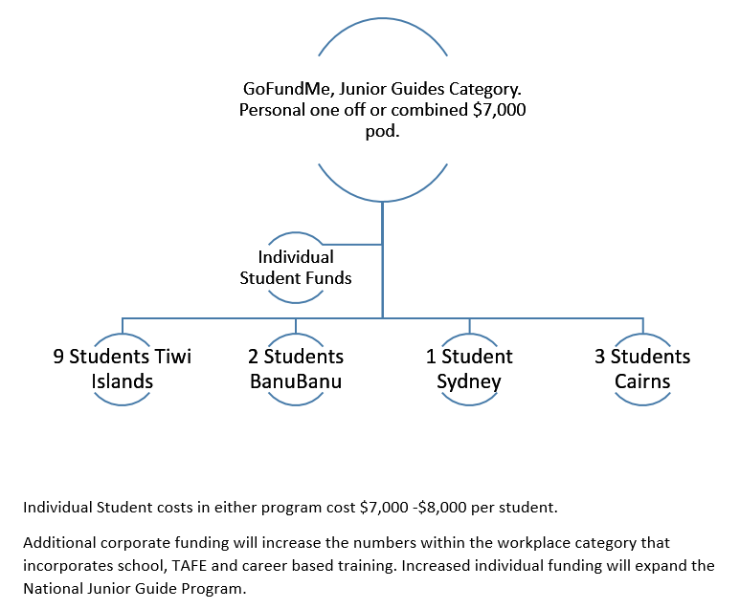
Individual GoFundMe Tiwi, Banu, Cairns, SYD
Junior Indigenous Guides or
Junior Indigenous Marine and Education
Notes:
INDIVIDUAL GOFUND ME MODEL CAN BE USED FOR EITHER.
Junior Indigenous Guides or
Junior Indigenous Marine and Education

Slide 23
Future Development
The program started with 2 students in 2016. It will expand to 30 students minimum in 2019.
It is currently privately funded with all students receiving $135 per day as salary when guiding, and all costs lunches, clothing and equipment provided if they are in the learning phase of the program.
JIME already has interested parties in NSW, Far North WA and Tasmania
Notes:
THE JUNIOR GUIDE PROGRAM HAS BEEN FUNDED PRIVATLY WITHOUT GOVERNMENT MONIES.
WE HAVE MUCH INTEREST AND IN THE FUTURE
I EXPECT SOME GOVERNMENT INVOLVEMENT
BUT NOT OVERALL MANAGEMENT
FOR JIME WE ALREADY HAVE INTERESTED PARTIES
IN NSW, FAR NORTH WA AND TASMANIA

Slide 24
Fund Management
Lachie Green ( Macquarie Bank) oversees the JIME funding.
OZFISH handle the financial account and transactions are fully accounted & documented.
https://vimeo.com/273489085
Notes:
MONIES ARE MANAGED BY OZFISH AND ACCOUNTING IS BY LACHLAN GREEN FROM THE MACQUARIE BANK
There is a link here if anybody would like to look further at some of the history.

Slide 25
THANK YOU FOR YOUR ATTENTION
INDIGENOUS
RECREATIONAL FISHING
TACKLE INDUSTRY
SEAFOOD INDUSTRY
COMERCIAL FISHING INDUSTRY
AQUACULTURE
Notes:
I HOPE IN THE FUTURE WE CAN HAVE A GENERATION OF AUSTRALIANS CONSIDERING AND NURTURING “ OUR FISHERY”
THANK YOU VERY MUCH FOR YOUR ATTENTION

