Slide 1
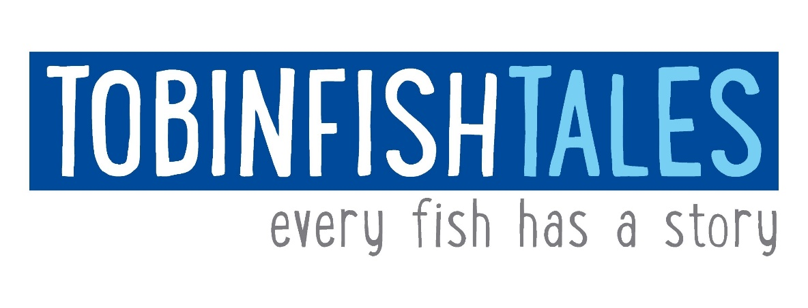
From Science to Seafood
Dr Renae Tobin

Slide 2
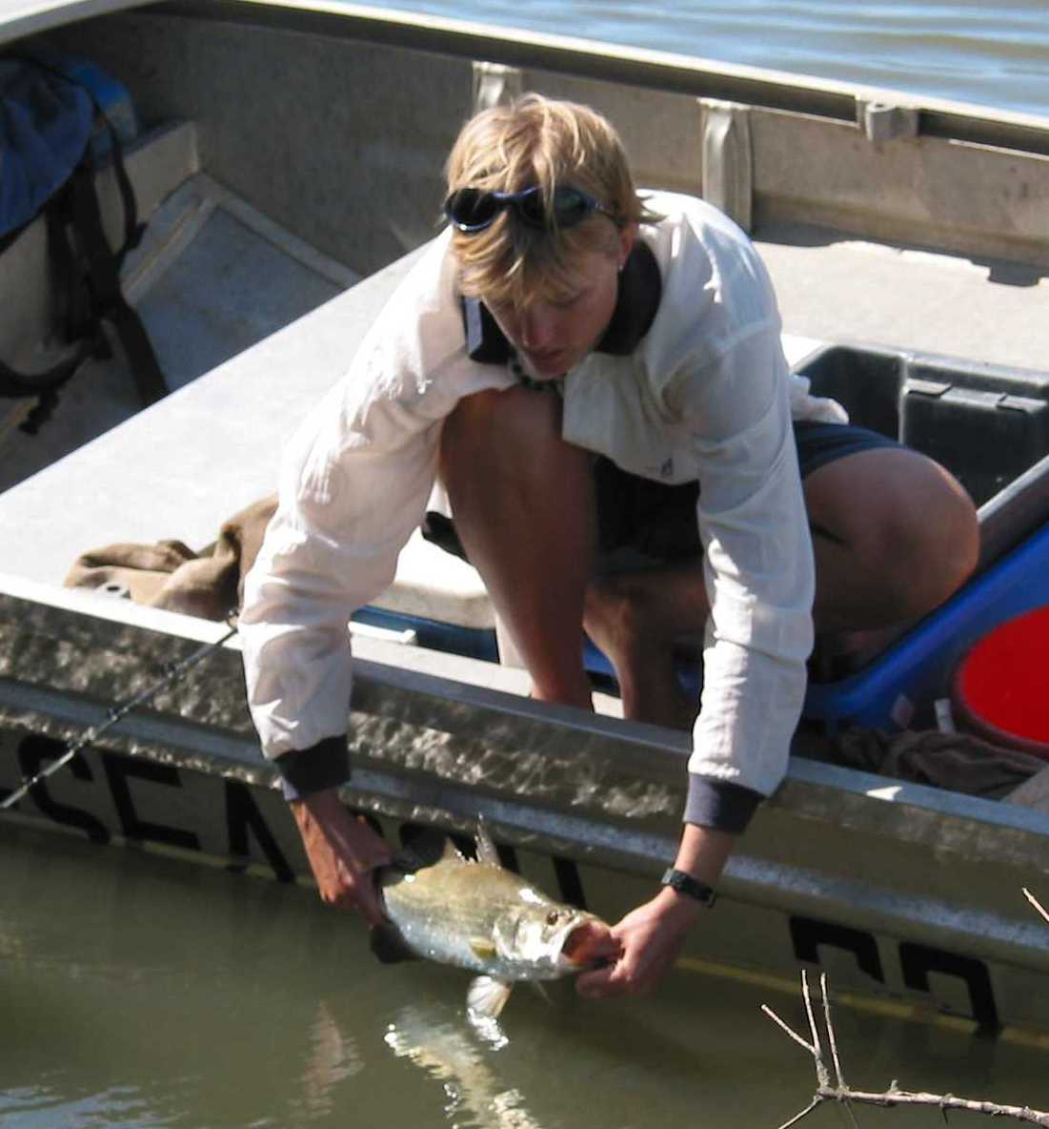
From Science …
Understanding what fish need …
Notes:
Ok, in the beginning … I started with science. To tell you a little about me, as a scientist
With a marine biology degree, I became more and more interested in fisheries ecology – i.e. doing science to understand what the fish need in order for a fishery to be sustainable. Things like age, growth, reproduction…

Slide 3
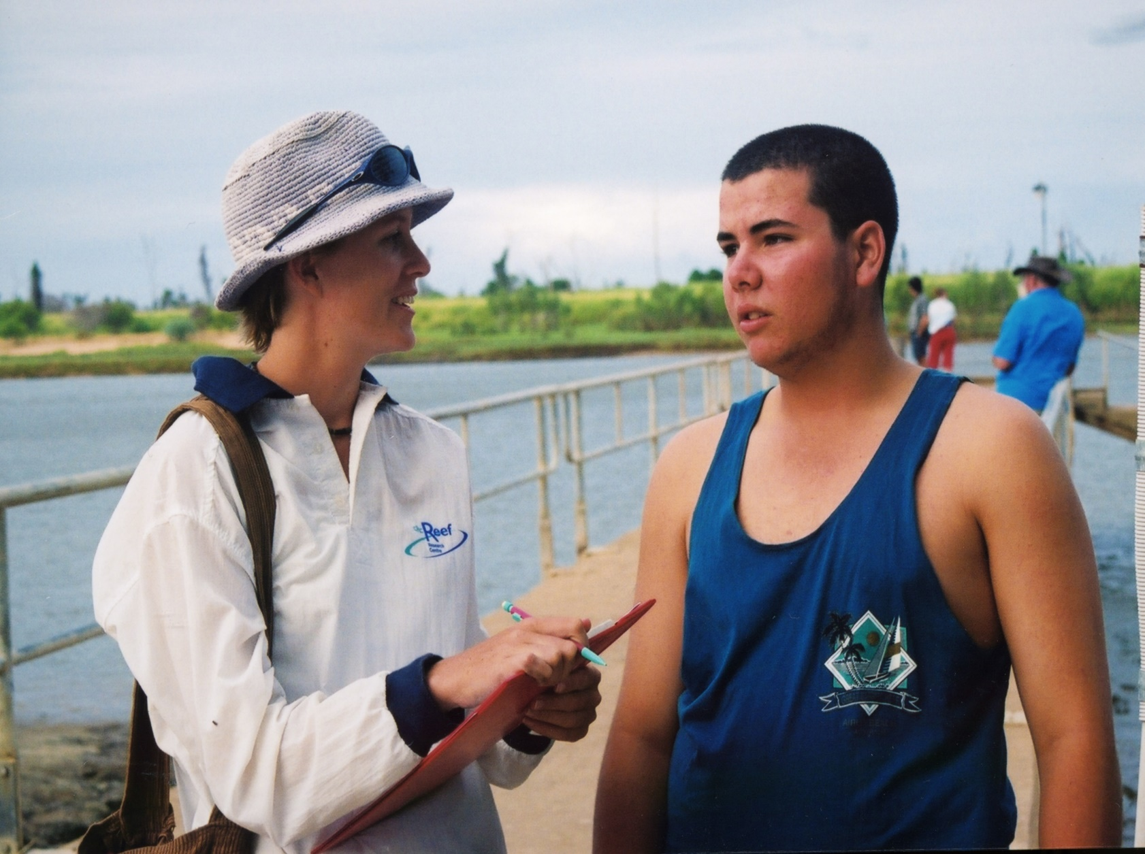
From Science …
In many cases, it is not the fish that need to be managed ……
What do the people need?
Notes:
Then, during my PhD, I started to switch to fisheries social science.
When I realised the fish would be fine if we weren’t here – it was the people that needed to be ‘managed’
My understanding of fisheries from a social perspective continued to grow, and I realised we really needed to understand the people – what drives them. What do they need to ensure a sustainable fishery, both ecologically and socially

Slide 4
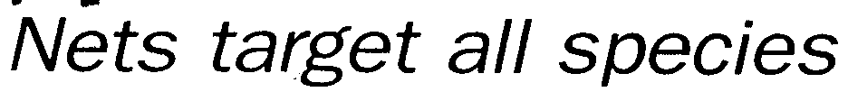
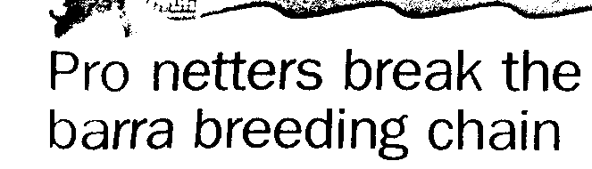
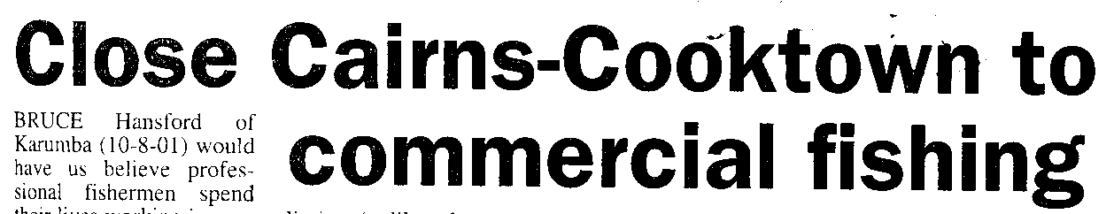
From Science …
Connections between different groups of people …
Negative perceptions
Disconnect between community and commercial fishing
Notes:
I also started to understand the connections (positive or negative, or lack of) between diff groups of people that were accessing fisheries in different ways.
When I explored perceptions of different sectors, I found a very negative perception of commercial fishing held by recreational fishers in particular, but also the general community
Where there may have previously been a connection between commercial fishing and community, this was certainly lost

Slide 5
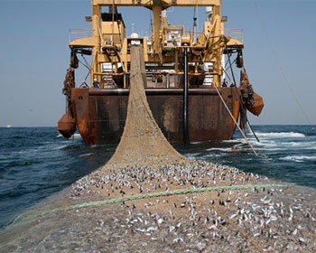
From Science …
Lack of accurate information
Lack of understanding
Notes:
A lot of these negative perceptions and lack of connection, however, were based on
a lack of information about fisheries – information they had was out of date, or inaccurate – many pictured industrial fishing, or even trawling for barramundi in estuaries.
This lack of understanding drove their perceptions of the industry.

Slide 6
From Science …
… disconnect
Affects recognised ‘value’ of industry to community
Commercial fisheries continue to lose ground to vocal lobby groups
Politicians make the decisions based on community ‘needs’
Hard to get correct information heard … and trusted
Notes:
This disconnect between commercial fisheries and the community is really important.
This is well known – I am talking to the converted here …
It affects the recognized ‘value’ of the industry to community.
Without a substantial value, commercial fisheries continue to lose ground to vocal lobby groups as
Politicians continue to make decisions on what they think the community needs.
How do we get the correct information heard, and trusted?
But my method of communication at that time was ineffective:
Scientific papers are only read by scientists
And reports – only read by managers (and probably only the technical summary ☺ )
Need trusted information to reach the community, to rebuild the link between fishers and the community

Slide 7
From Science …
Fisheries = Public resource
Seafood consumers want local seafood
Lack of information …
(Tobin et al. 2010)
Notes:
But fisheries are a public resource.
Which means we need to think of the consumers of that resource
When I surveyed seafood consumers, I found that 91% of the Qld coastal population ate seafood at least once a year,
Most BOUGHT that seafood rather than catching their own
Most would prefer to buy local seafood, and are willing to pay more for it
They expressed, however, that they didn’t buy local seafood as often as they would like due to a lack of trust in what they’re getting
Again … lack of information..

Slide 8
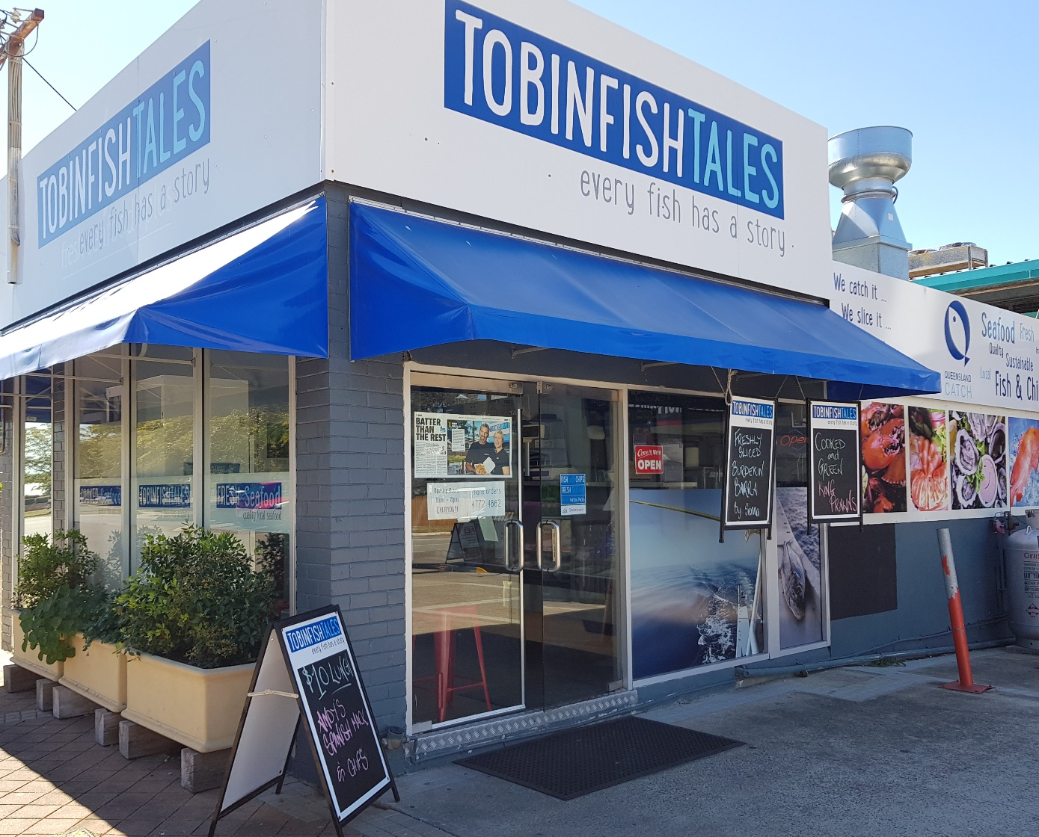
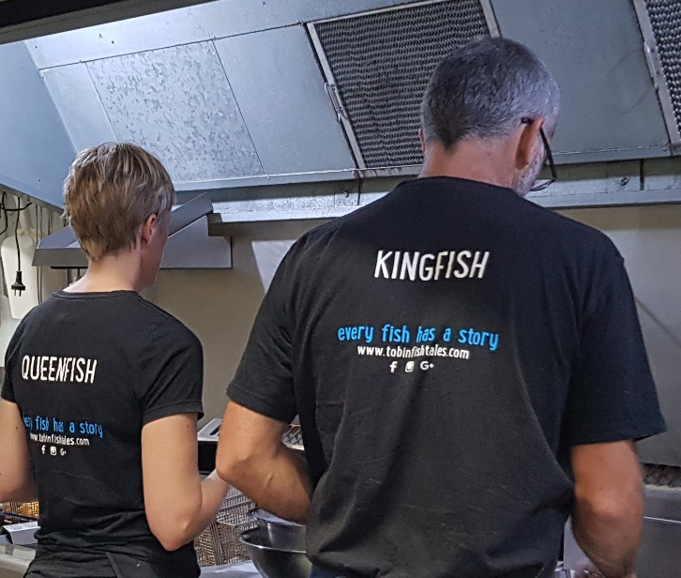
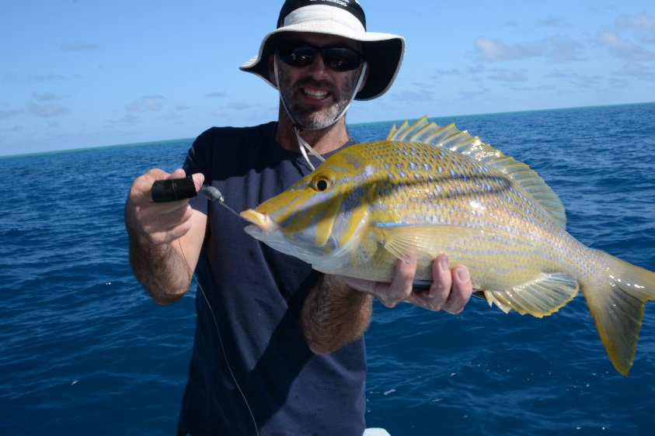
… to seafood!
So … let’s open a shop!
Notes:
This brings me to my transition to seafood
We thought, let’s leave science for a while, and open up a shop!
A little one for now … because let’s face it, we’re scientists with zero experience in running a shop or cooking seafood in bulk!
I need to point out here, for those that don’t know, that I took this leap with husband Dr Andy Tobin – also an experienced fisheries scientist, and commercial fisher

Slide 9
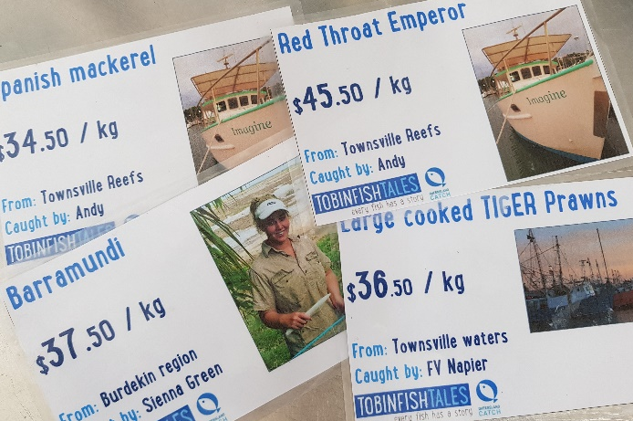
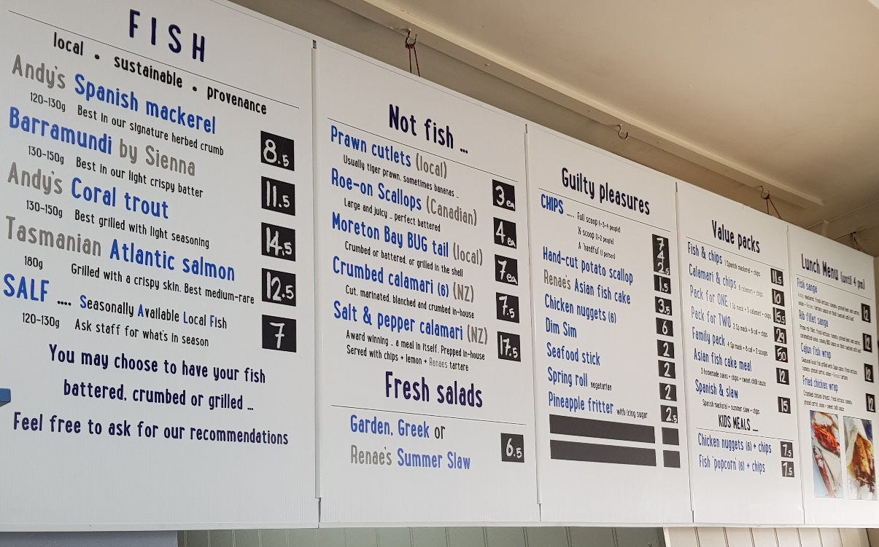
… to seafood!
  The idea:
  Showcase local seafood!
  Talk directly with the consumers
  Sell fresh and cooked local seafood, and the story about it’s source
Notes:
The idea was that we would showcase local seafood!
Talking directly with consumers about the fresh and cooked seafood they were buying, telling them the story about where it comes from, who caught it, and how

Slide 10
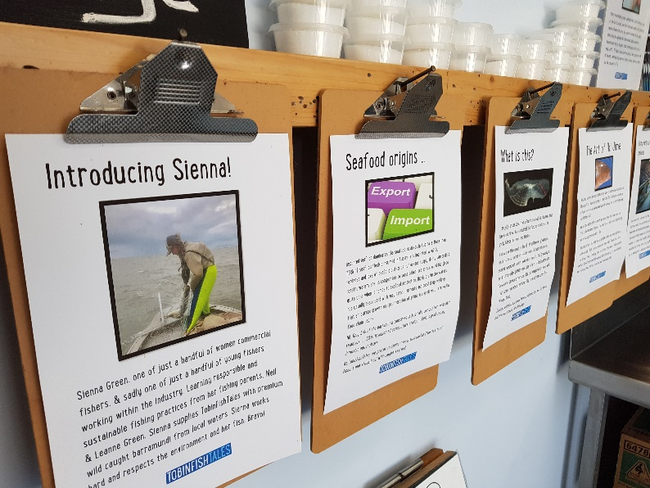
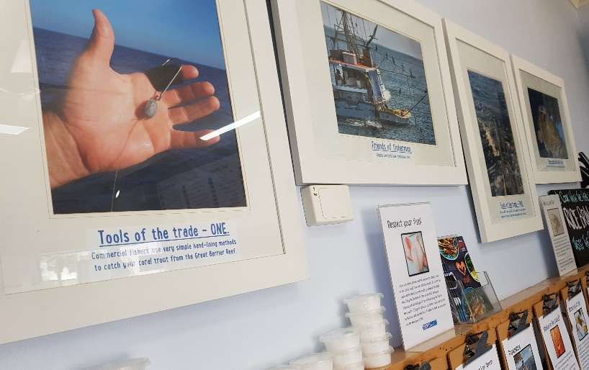
… to seafood!
The idea:
- Provide information about how seafood is caught, and how fisheries are managed
Notes:
For those that are interested, they could read information boards or talk to us about how fisheries operate or are managed, and interesting tidbits about fishing

Slide 11
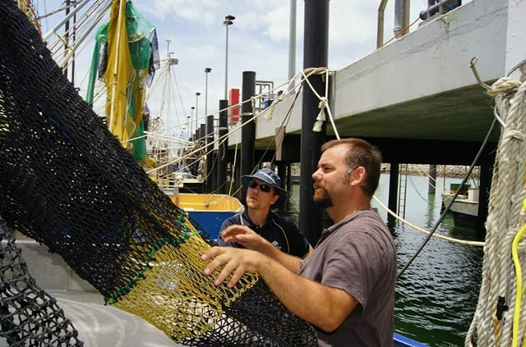
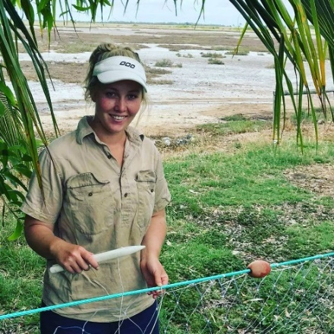
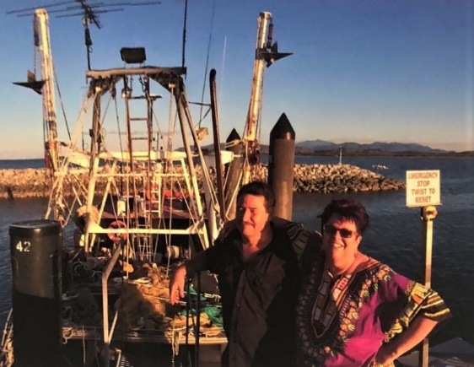
… to seafood!
The idea:
‘Humanise’ the industry – put names and faces to the products
Rebuild the link between industry and community …
at least in 1 small suburb!
Notes:
We wanted to ‘humanize’ the industry…
And ultimately rebuild the link between industry and community – at least in 1 small suburb!

Slide 12
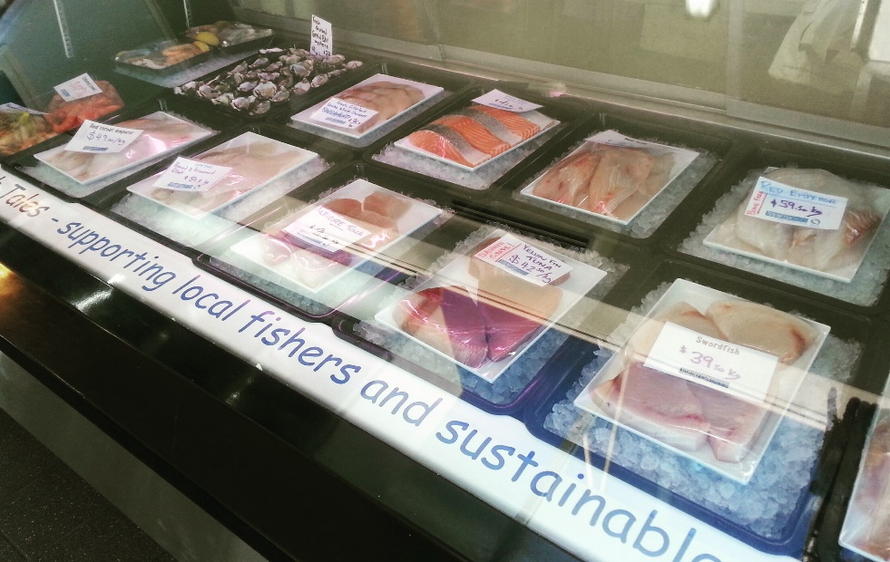
Showcasing local seafood
Well received by customers
“.. So great to be able to eat locally caught sustainable fresh fish!” (Facebook)
“…This place buys only from local fisherman, tells you which fisherman caught the fish you are eating, and then proceeds to cook up the best fish and chip plate you will ever have anywhere…” (Trip advisor)
“…The owners are really passionate about making the fishery sustainable and they even catch the fish themselves which is great and helps make it the best fish and chip shop in Townsville. (Google)
Notes:
So, what have we found? So far, the idea has been well received by customers, and we’ve grown the business substantially.
While I can’t quote any stats on what proportion of our customers come to us specifically because we sell local seafood, we have a lot of positive comments on social media ☺

Slide 13
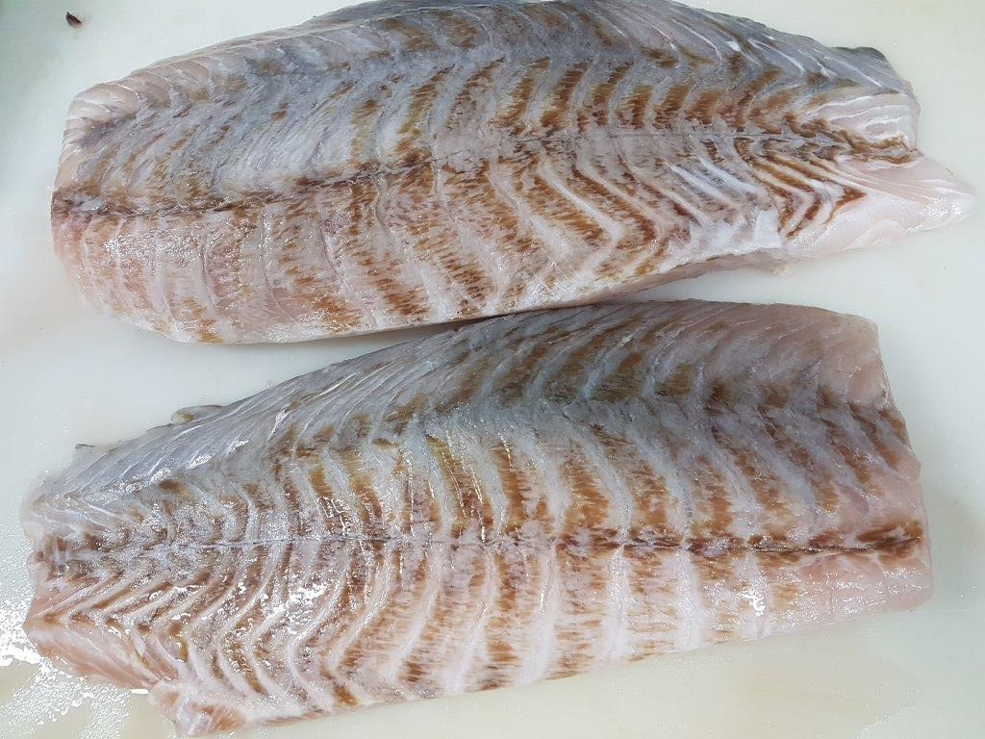
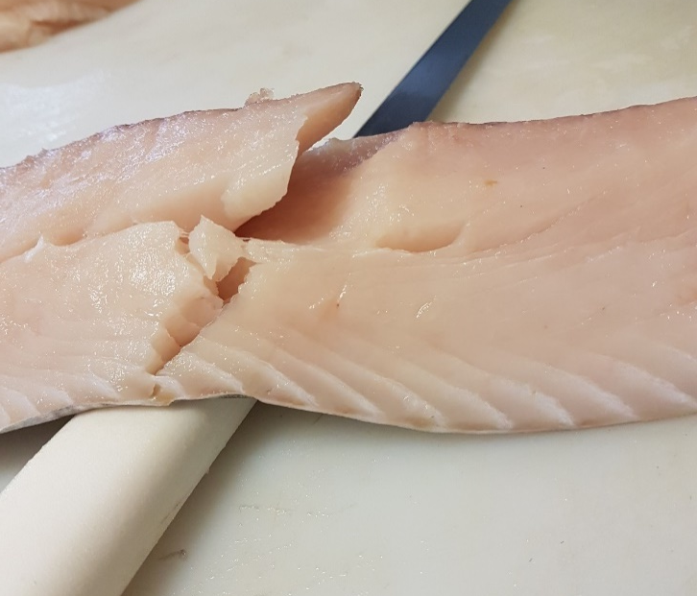
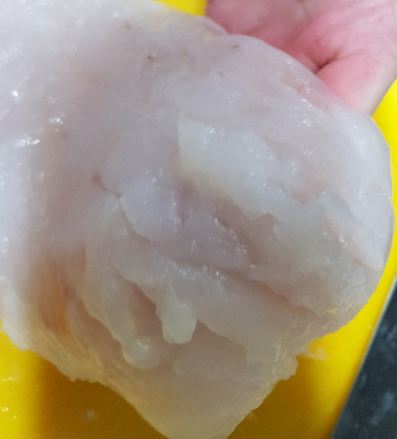
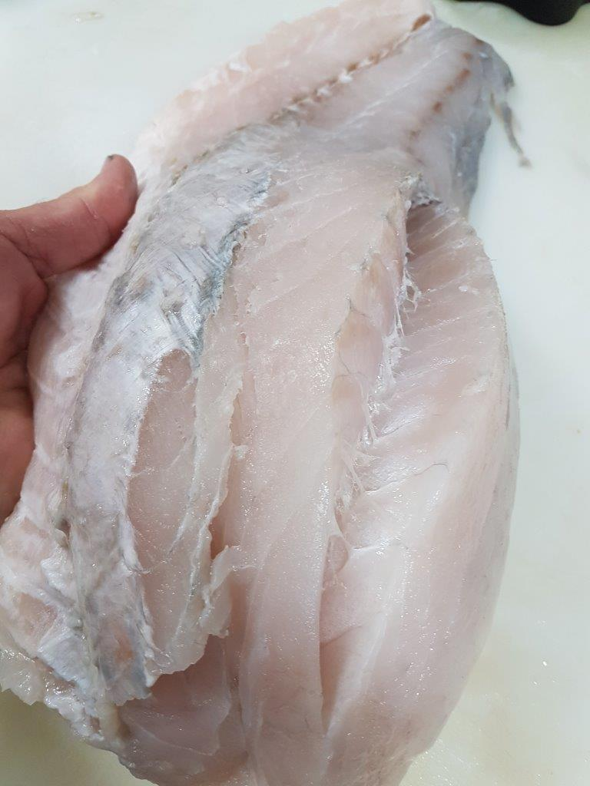
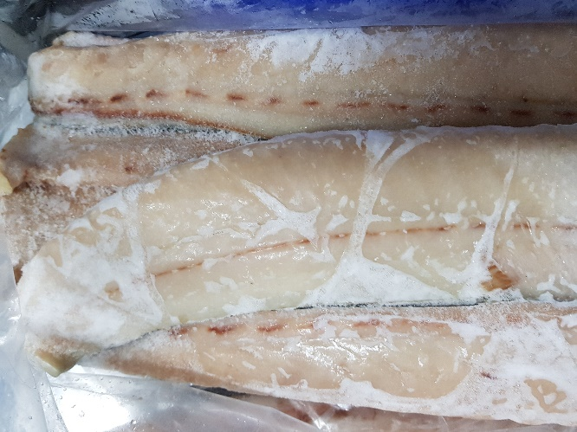
The challenges
Sourcing local seafood of consistent quality
No awareness of what happens beyond the box…
All priced the same regardless of quality
Notes:
But, there have been some substantial challenges
First of all, it’s hard to get product of consistent quality.
Hard to showcase local seafood when it arrives like this – watery, brown barra fillets that have been frozen slowly; freezer burnt mackerel from overpacked boxes with not enough plastic; Shattered fillets; Poorly handled fish
Even a delivery guy joked with us that fishers tend to take a perfectly good square box and turn it into a football!
Fishers tend to have little knowledge of what happens to the fish ‘beyond the box’
Importantly, when I buy from our local wholesaler, I never know what I’m going to get. We pay the same price for well handled product as we do for poorly handled product – there is no direct benefit to these fishers to taking care with the product, and there is option for me to choose product based on quality.
And there is no feedback loop or pathway for communication from me a an end-user, to the fisher

Slide 14
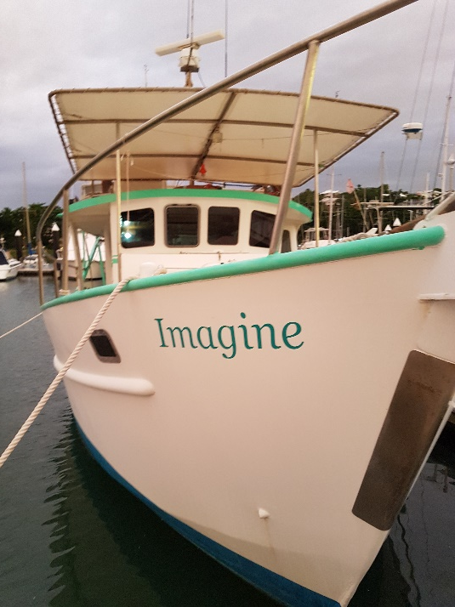
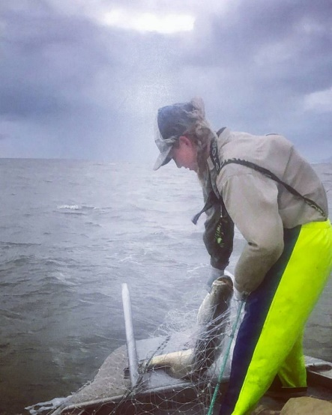
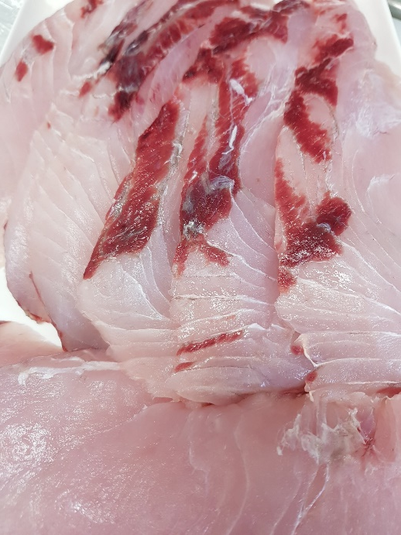
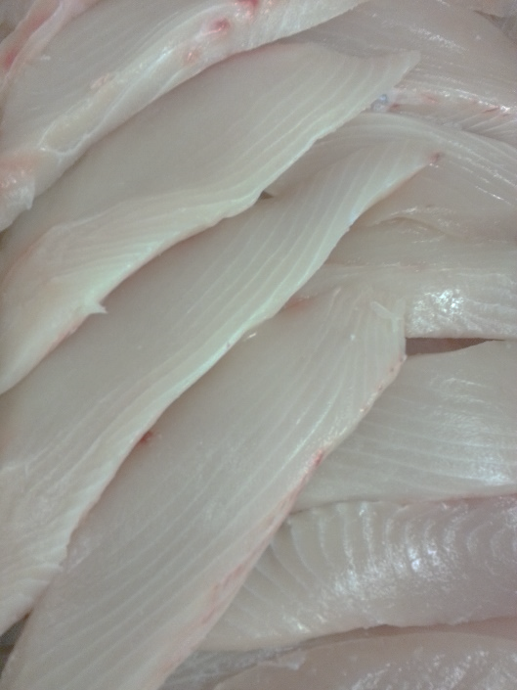
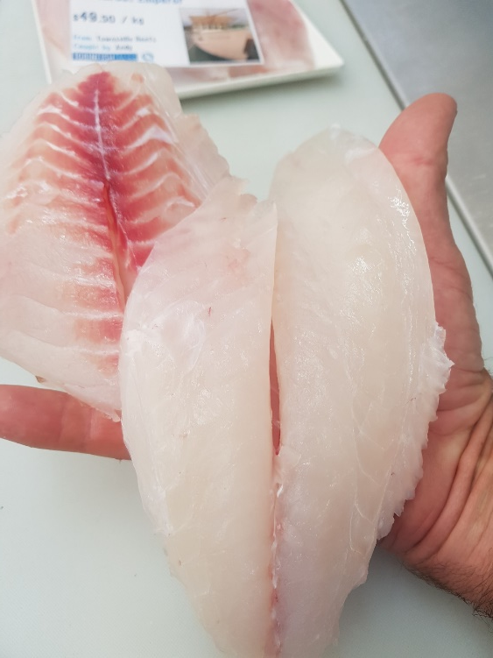
The solution
Catch our own …
or buy direct
Notes:
So we catch our own, or buy a lot directly from fishers that we have a relationship with
This controls quality, and we choose to pay more for this …

Slide 15
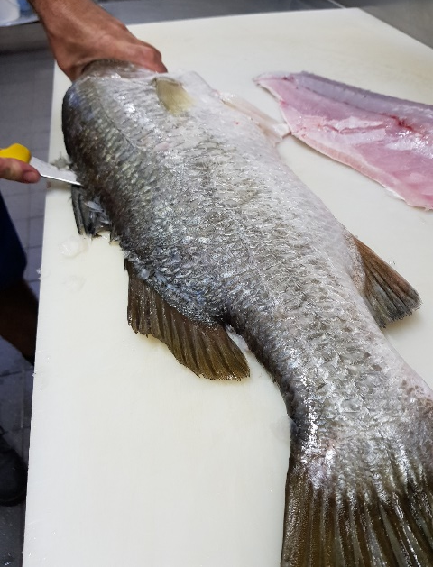
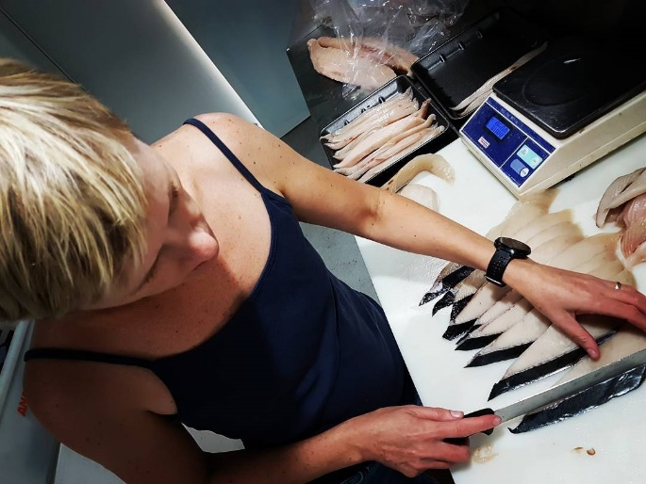
The solution
Catch our own …
or buy direct
Doing most of the processing ourselves
Issue:
- time consuming
- not economical
Notes:
We do most of the processing ourselves but because it comes in primarily as whole fish – this costs us a lot in terms of processing time.
As a small fish and chip shop with 2 people – Andy and myself – who can cut fish, this doesn’t make good business sense
Understandable why this is not common practice for fish and chip shops.
The industry, and us, are competing with imported or farmed product, which is supplied by the carton in ready cut portions. You can be assured it comes in the same form every time.

Slide 16
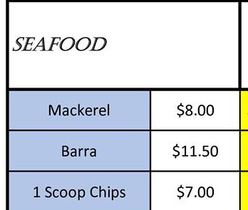
The challenges
Labelling of cooked seafood
We buy with emotion …
Notes:
This then also brings us to the current challenge surrounding the labelling of cooked seafood. A hot topic
The price we can charge is relatively limited by our nearby competitors.
Our nearest competitor is selling ‘mackerel’ – which could be any mackerel – or ‘barra’. We know these are not the same as what we are selling. But the consumer does not. Some shops even just sell ‘fish’!
From who knows where ….
And why not? They have fish cut to portion size. All they have to do is thaw it. They have a time advantage, and they can put a decent mark-up on it.
And the customers are generally none the wiser.
For us, we can’t compete on price – our mark up is not enough to make it worth the time and effort for most shops
We personally buy with emotion. We have been involved with the Qld commercial fishing industry for a very long time, in various capacities, and care a lot about the industry. We want to showcase their product. But if we bought with more business sense, perhaps we wouldn’t … it’s not easy.

Slide 17
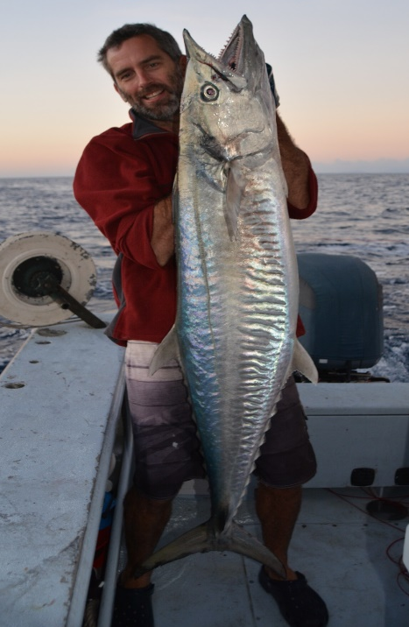
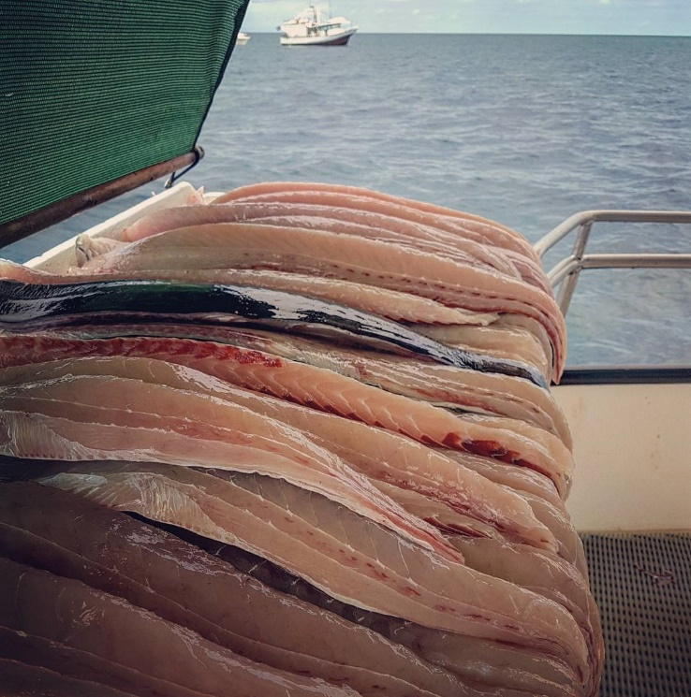
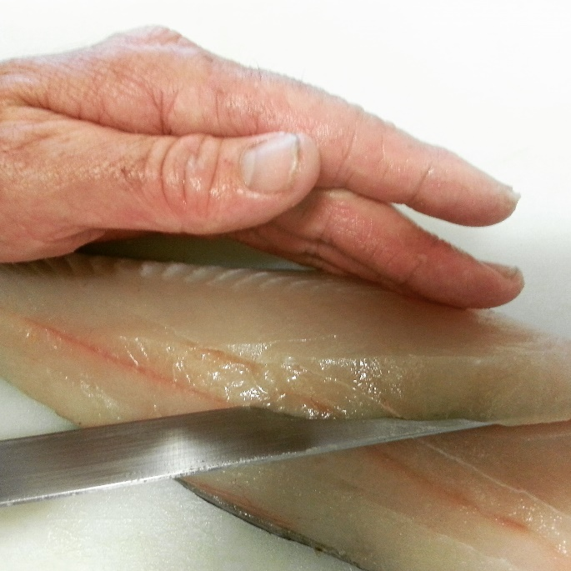
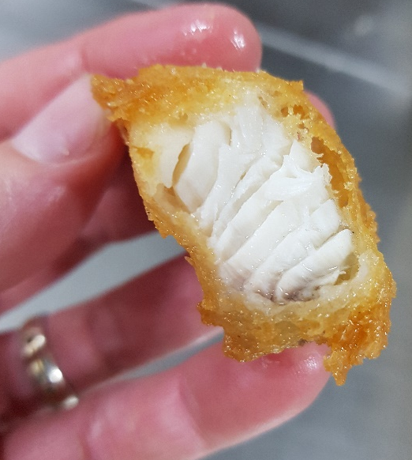
Industry solutions?
Industry training
‘beyond the box’
from capture to cook
Better feedback loop
Notes:
Ok, what about industry-wide solutions?
Andy and I have talked a lot about the potential for industry training.
For those fishers that are interested in learning about what happens ‘beyond the box’.
You could walk fishers through the whole process, from capture to cook, to clearly show the needs of the end user.
Sort of like the FRDC leadership program, but more directly linked between the fisher and their end user.
How many wild catch fishers ask their buyers for feedback on their product??
There is no feedback loop, or pathway for communication between fisher and end user / consumer
That’s why wholesale chain is fraught with danger – no feedback to fishers with poor product.

Slide 18
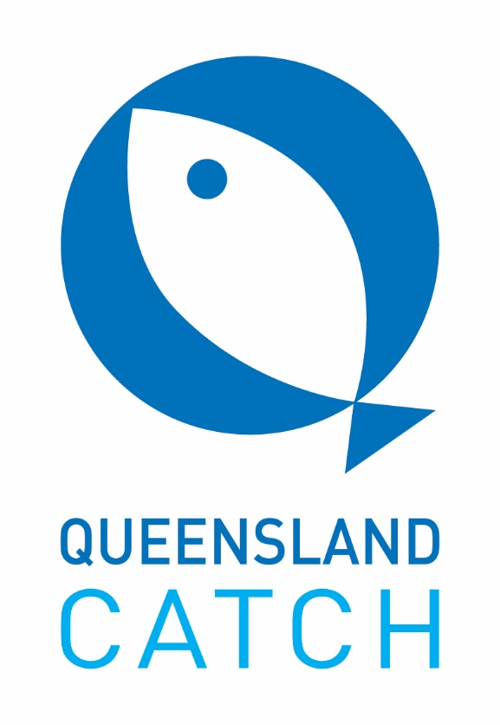
Industry solutions?
?
Stamp of approval / logo?
- Recognition of quality of product
- Associated $ reward
- Encourage greater involvement
Relationships = key
Adopt a fisher?
Notes:
We’ve also had some discussion surrounding use of logos.
E.g. there could be some sort of ‘stamp of approval’ or logo, to recognize high quality product, and therefore reward fishers for their efforts. If other fishers see there are rewards for good handling of product, more might follow suit.
We have adopted Qld catch and we present it proudly in our store. Because it’s clear that our seafood is from Qld, and wild caught. Thought it would be a way to unite fishers and showcase Qld seafood, but if you go to Instagram and type in #Queenslandcatch, you’ll find over half of the posts are ours!
Fishers can display these logos if they pay a fee, but there is no criteria they have to meet, apart from fishing in Qld. So the true benefit of the logo is lost.
We also have found that customers don’t ask about the logo. They talk to us, and trust us as their seafood provider.
They ask about the fishers. They have started to attach the seafood they buy with an individual. “Has Sienna been fishing?”. “Have you got Billy’s prawns?”
So perhaps the logo could be useful at the business level – to help recognize and reward quality product. Make it easier for shops to be confident in the product they’re buying.
But at the consumer level, what is needed is trust and relationships.
Maybe shops should ‘adopt a fisher’ and hero them as individuals?

Slide 19
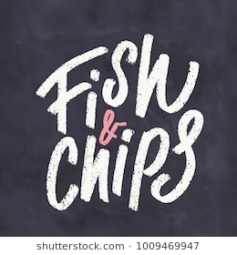
Industry solutions?
Labelling of cooked seafood
Inform customers …
Allow for choice
Notes:
This all leads on to better labelling of all seafood, including cooked seafood.
If all stores are required to label their seafood correctly, and state whether their products are farmed or wildcaught, local or imported,
Then customers can make an informed choice about what they would like to spend their $ on.
And perhaps highlight and recognize the value of local seafood to the community

Slide 20
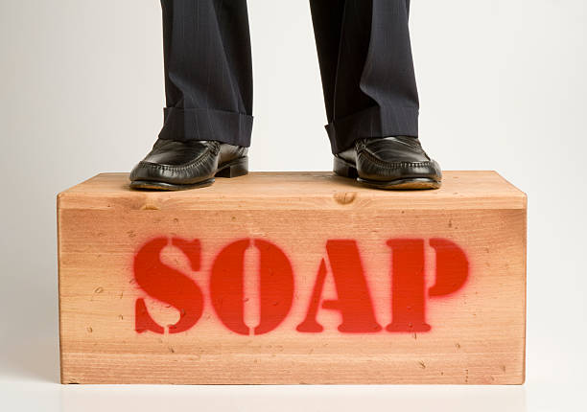
Solutions?
Fishery managers and scientists need to be more vocal
Address negative media
Provide information to point-of-sale businesses
Notes:
Finally, rebuilding the connection between industry and community can’t be left to the fishers and the retailers alone.
Fishery managers, are you proud of the work you are doing to manage your fisheries?
Stand up and say so!
Scientists, are you confident in your findings?
Find a way to communicate it!
Even I, as a scientist, was unsure what I was ‘allowed’ to say outloud in the political climate that is fisheries management.
even as a scientist with the knowledge I have, I often felt I has to whisper “I support the commercial fishing industry”.
There is so much negative media that goes unchecked, with no response from those who are in charge or have knowledge of these fisheries
I understand constraints of ‘approved’ statements – perhaps get some ‘ready-to-go’, pre-approved statements up your sleeve.
Managers could also use point-of-sale businesses as information or communication hubs.
Not every fish and chip shop has owners with fisheries PhDs! Help them find the information they can share with their customers, and make a difference in more than just 1 small suburb…

Slide 21
Thank you!

