Slide 1
The Victorian Seafood Experience!
By Johnathon Davey
Executive Director – Seafood Industry Victoria

Slide 2
Today’s Presentation:
Our new Strategy
The Victorian Seafood Brand
The Victorian Seafood Experience
Industry benefit
To date…
The future?

Slide 3
Our New Strategy

Slide 4
The Victorian Seafood Brand
Notes:
Showcasing the people, product and places of Victorian Seafood
Increasing public awareness of the industry and its contributions (social, economic, health, environment, tourism & hospitality, etc.)
Creating destinations and experiences whereby people want to go to a destination and have an experience while they are there and seafood becomes core to that experience
Shaping (influencing / owning) the interaction between consumer and product – in multiple contexts (supermarkets, restaurants, F&C shops, etc.) through various media (traditional, social, labelling, campaign, etc.)
Linking with localised learning (museums, underwater discovery, tours) and hospitality

Slide 5
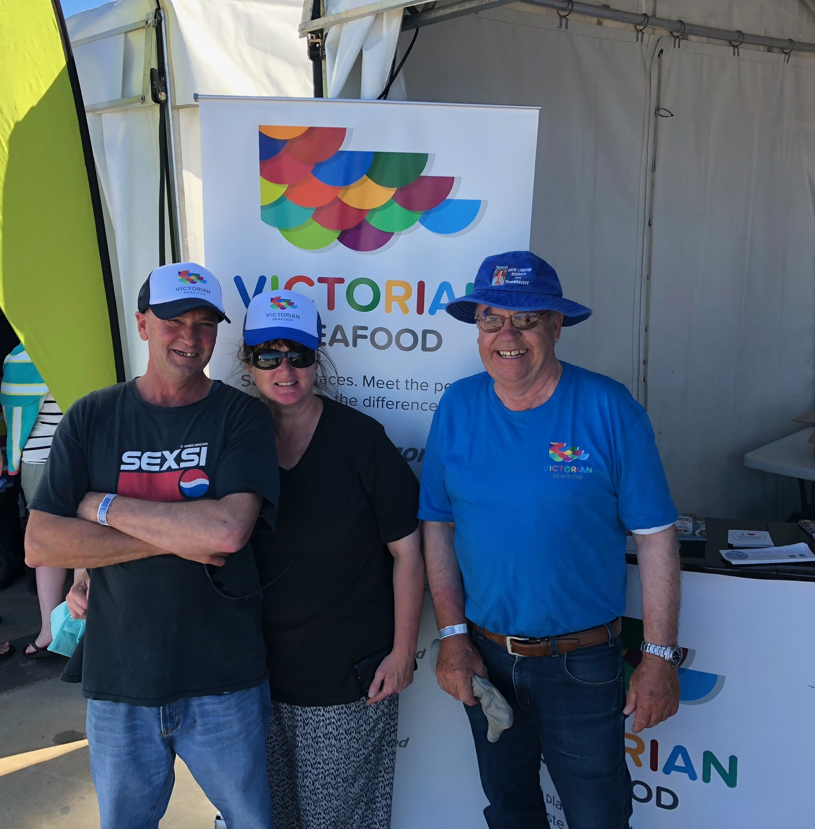
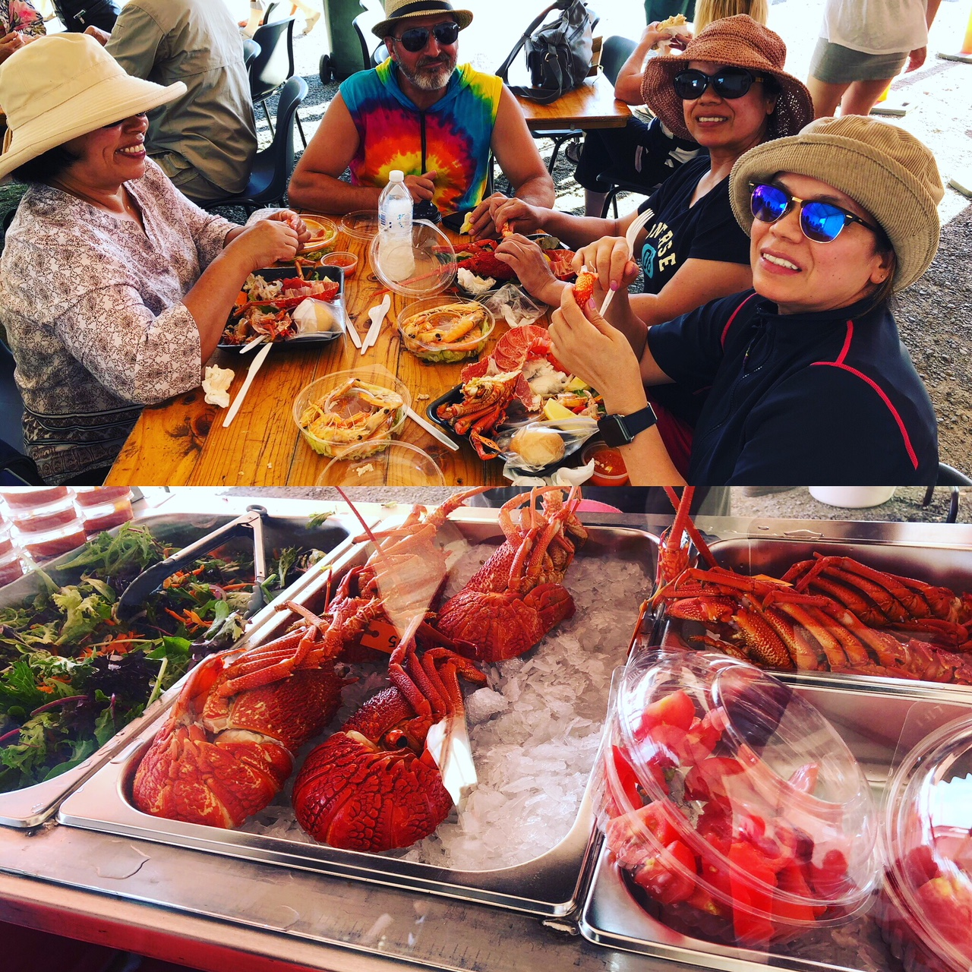
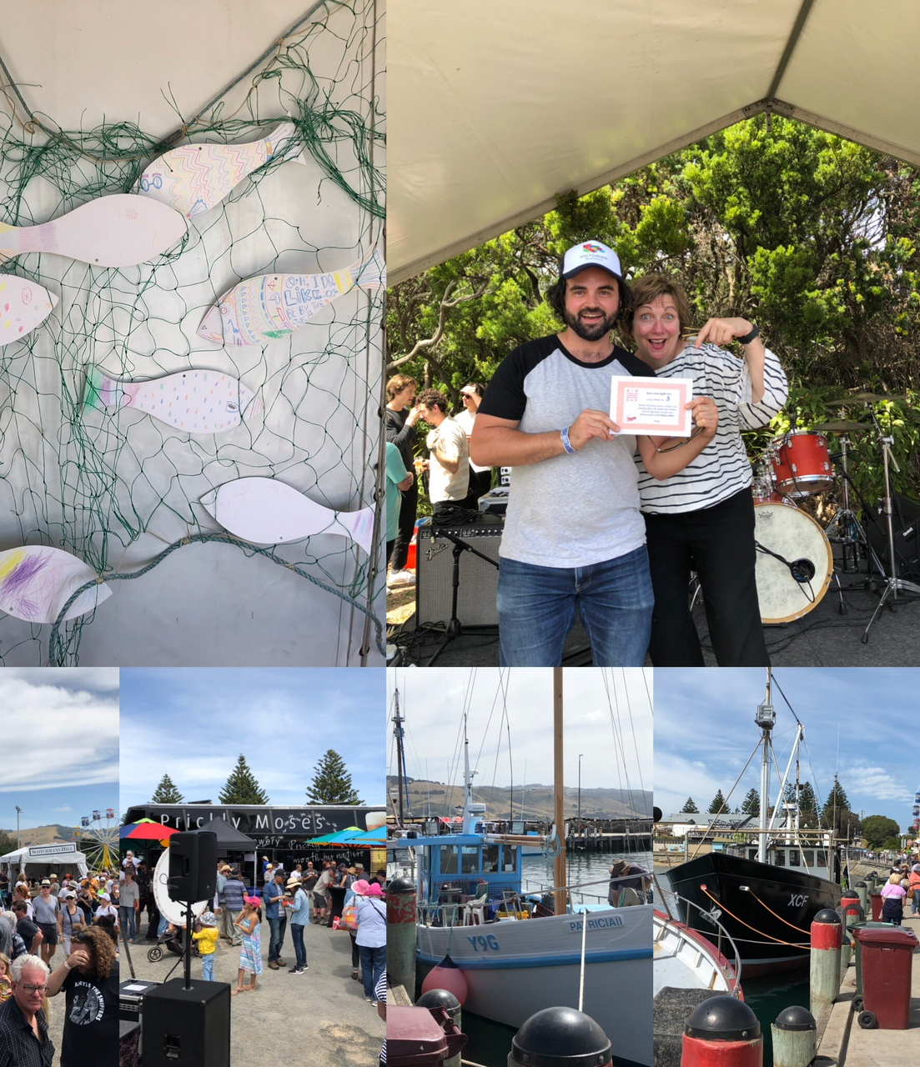
The Victorian Seafood Experience
  Regional seafood festivals
  Meet the Producer events
  (visit: https://www.apollobay.vic.au/apollo-bay-news/community-news/946-conversations-on-the-edge )

Slide 6
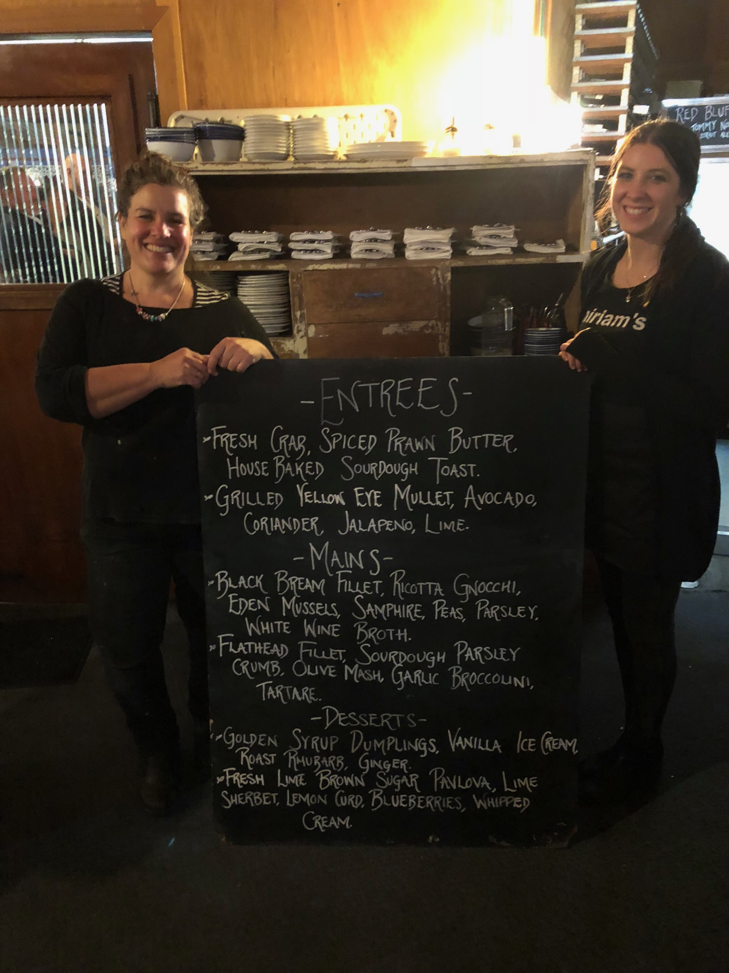
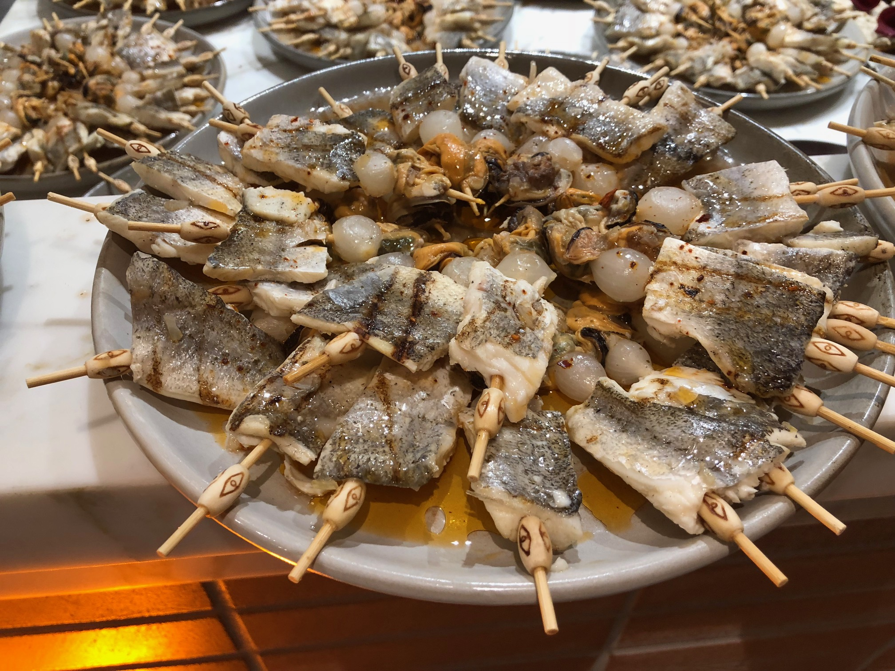
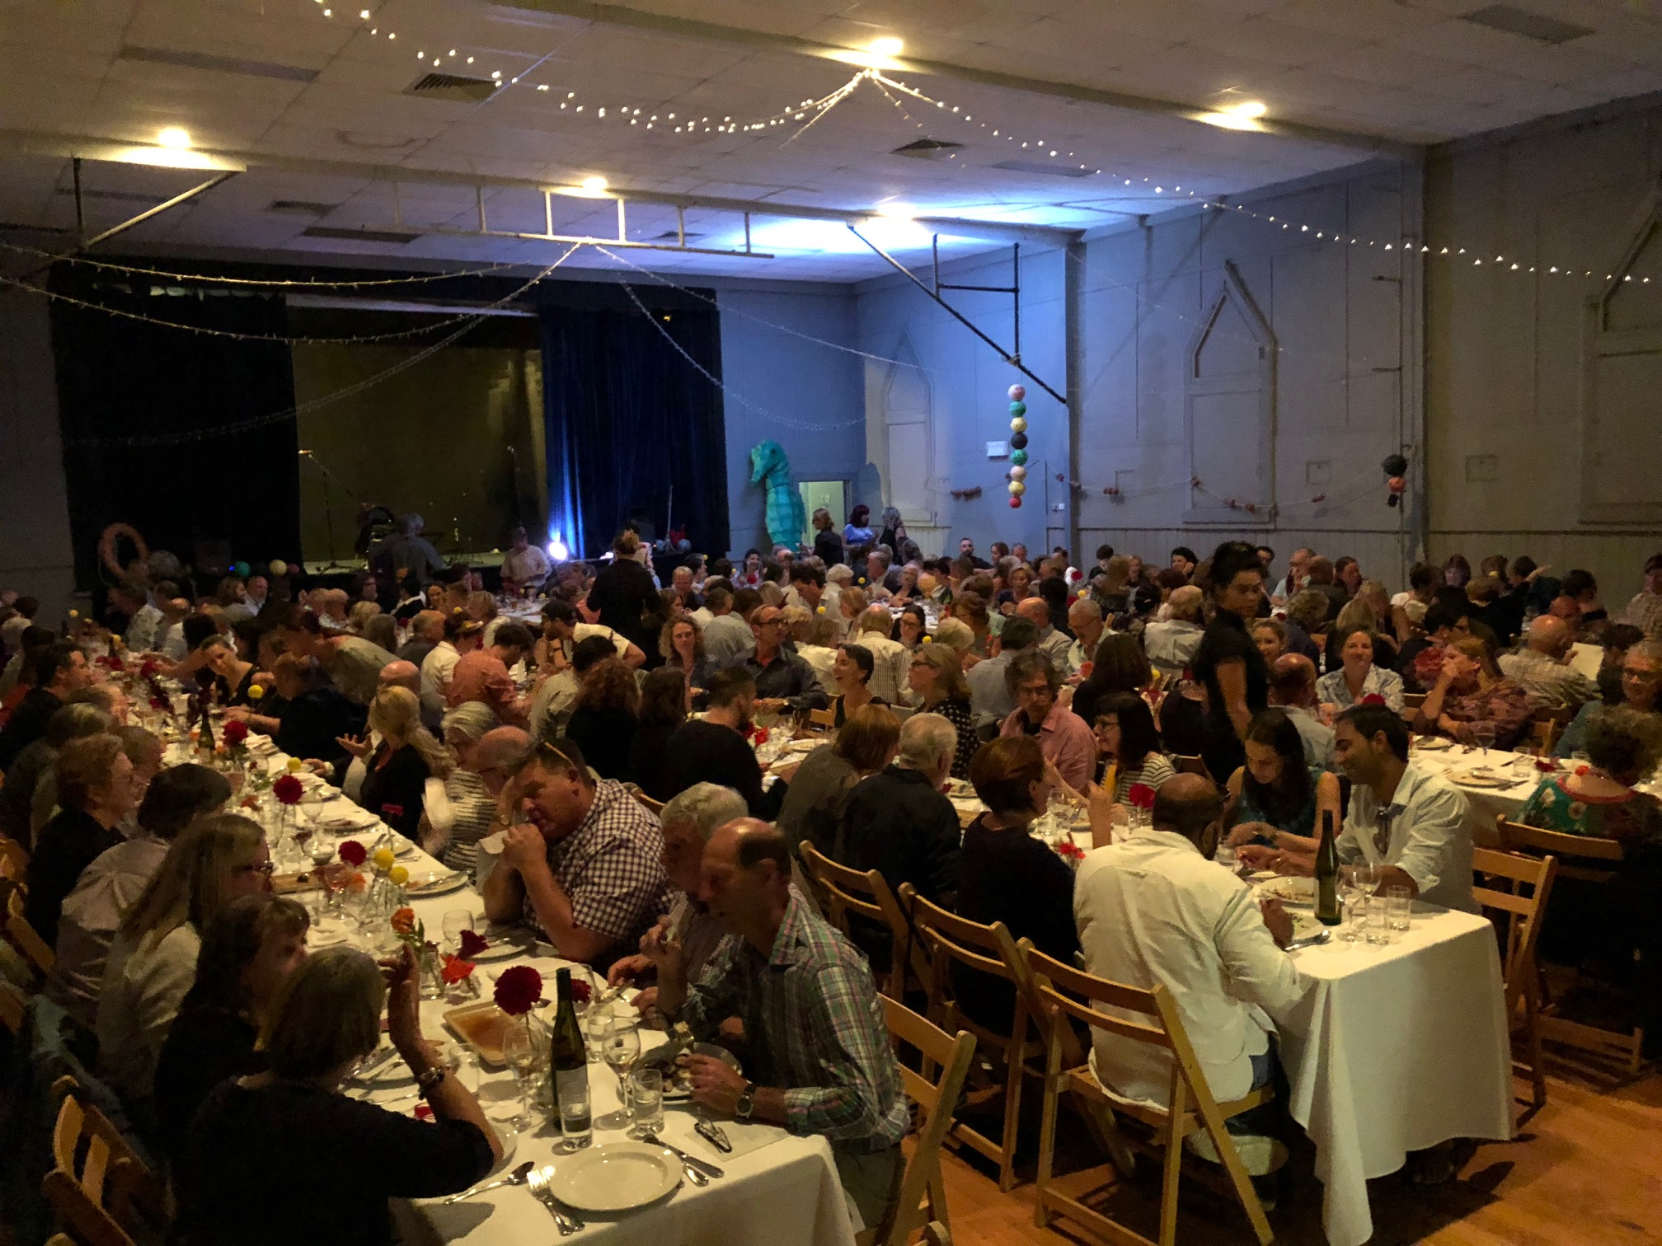
The Victorian Seafood Experience
Seafood Specific Dinners
Australian Open 2019 Launch
Working with high profile Chefs

Slide 7
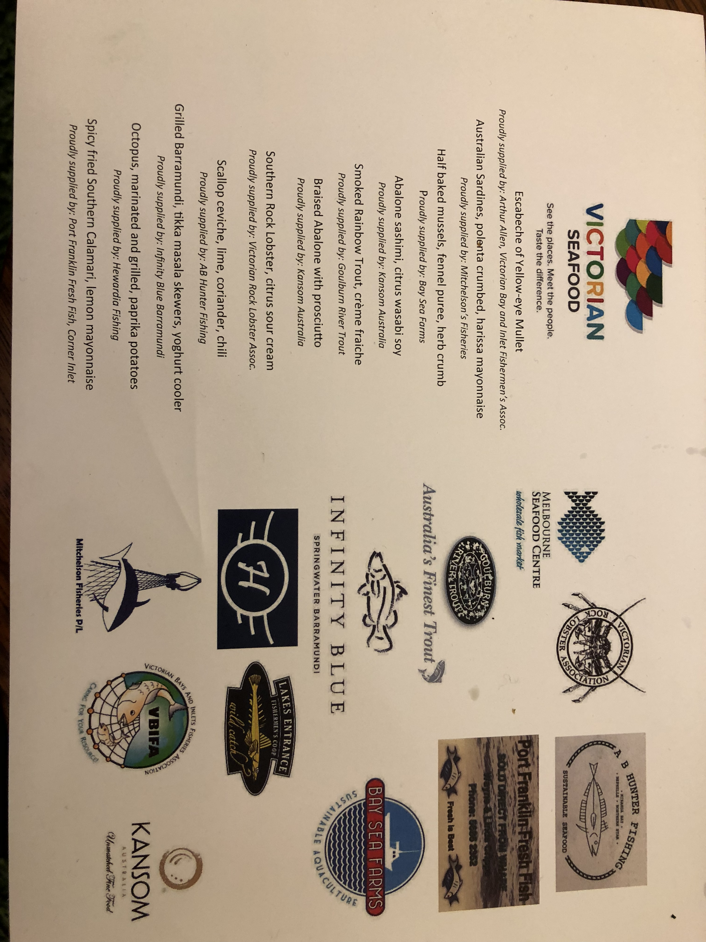
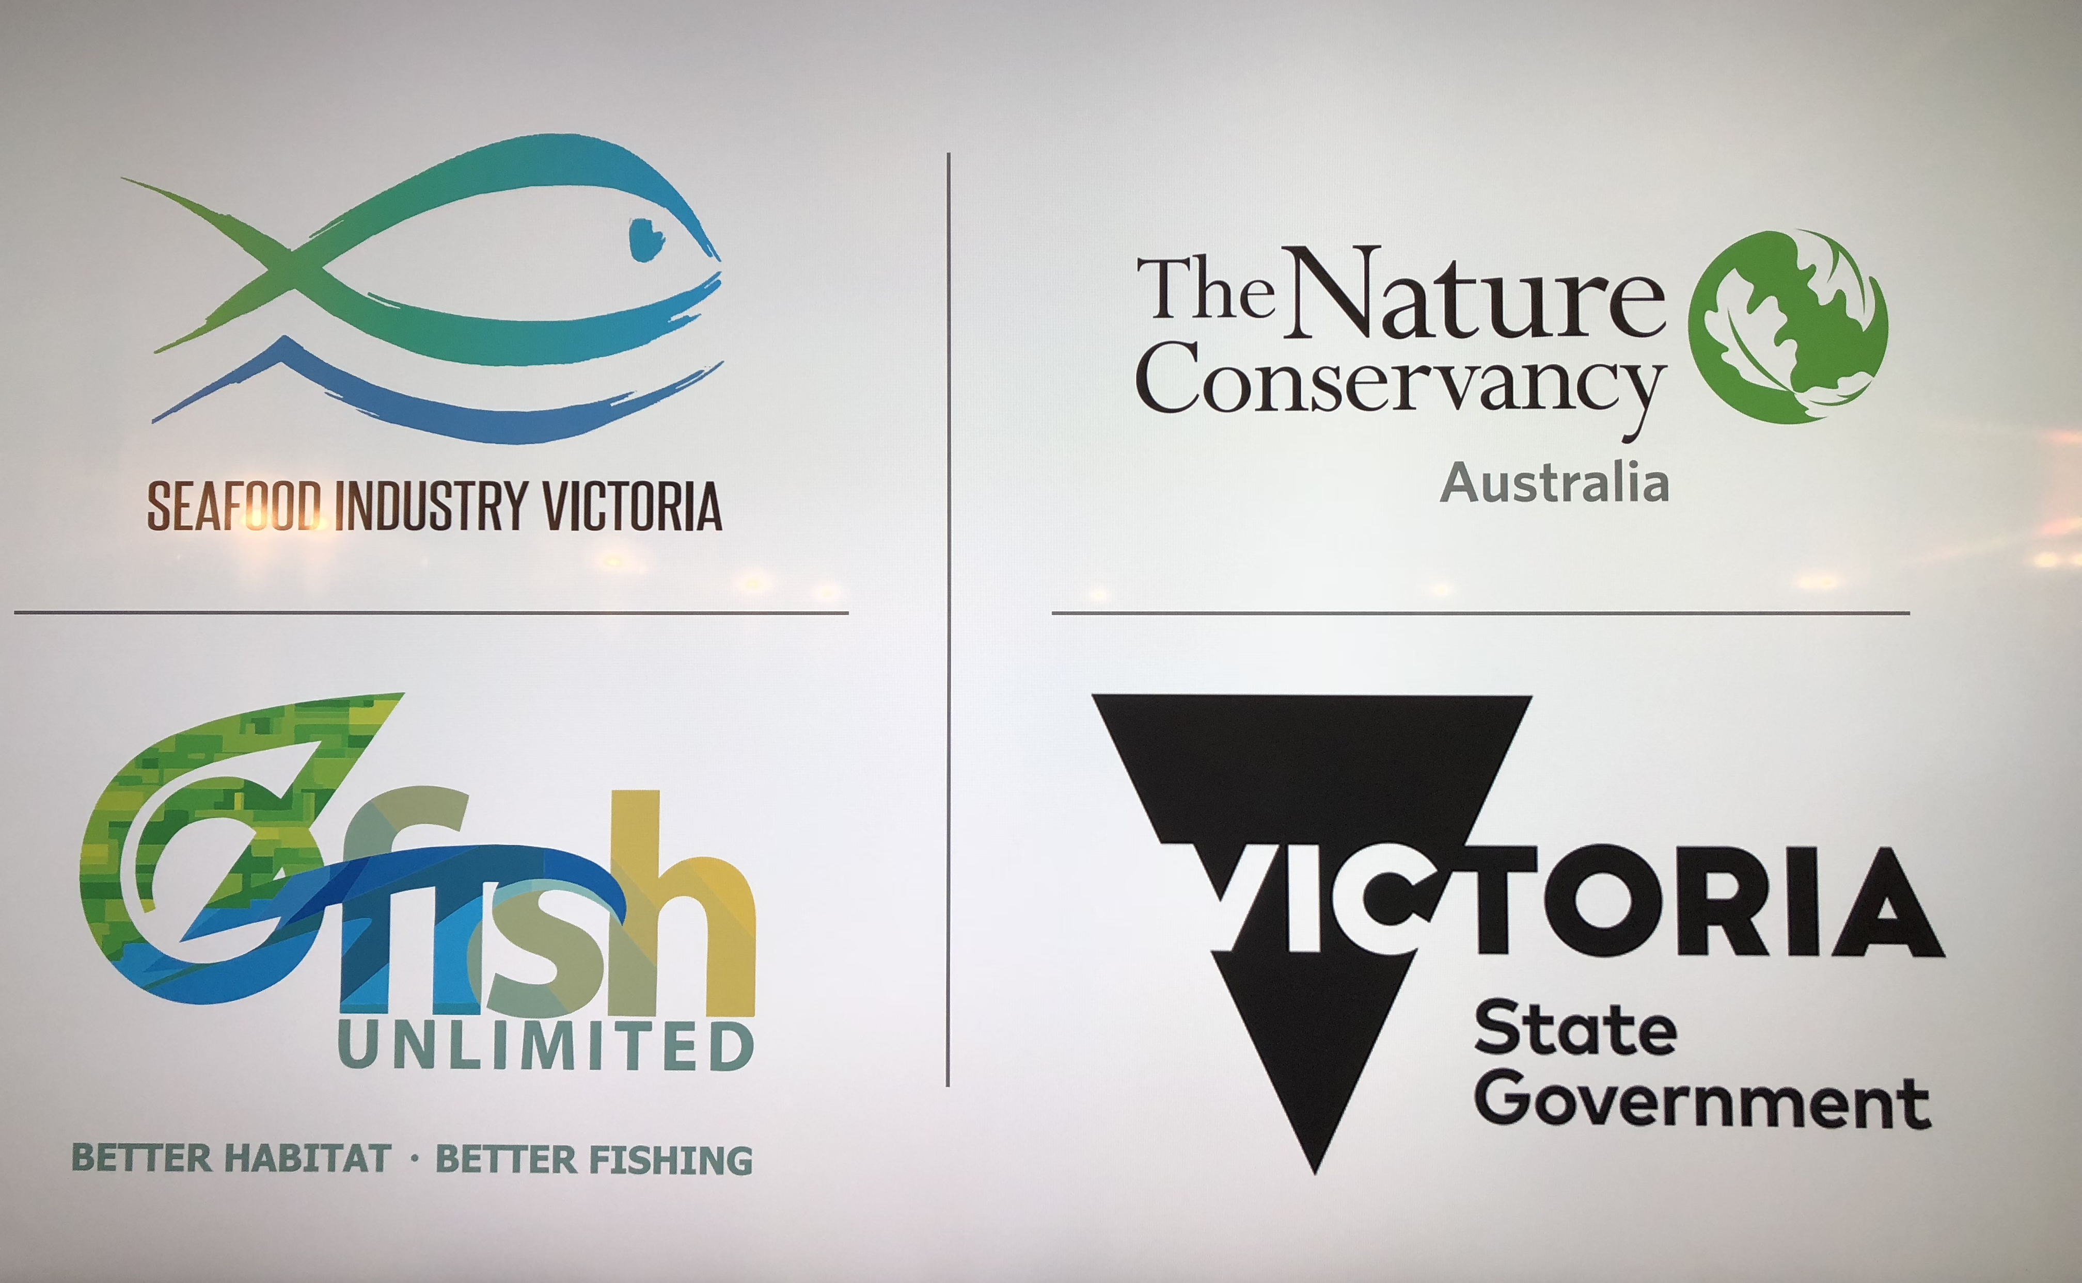
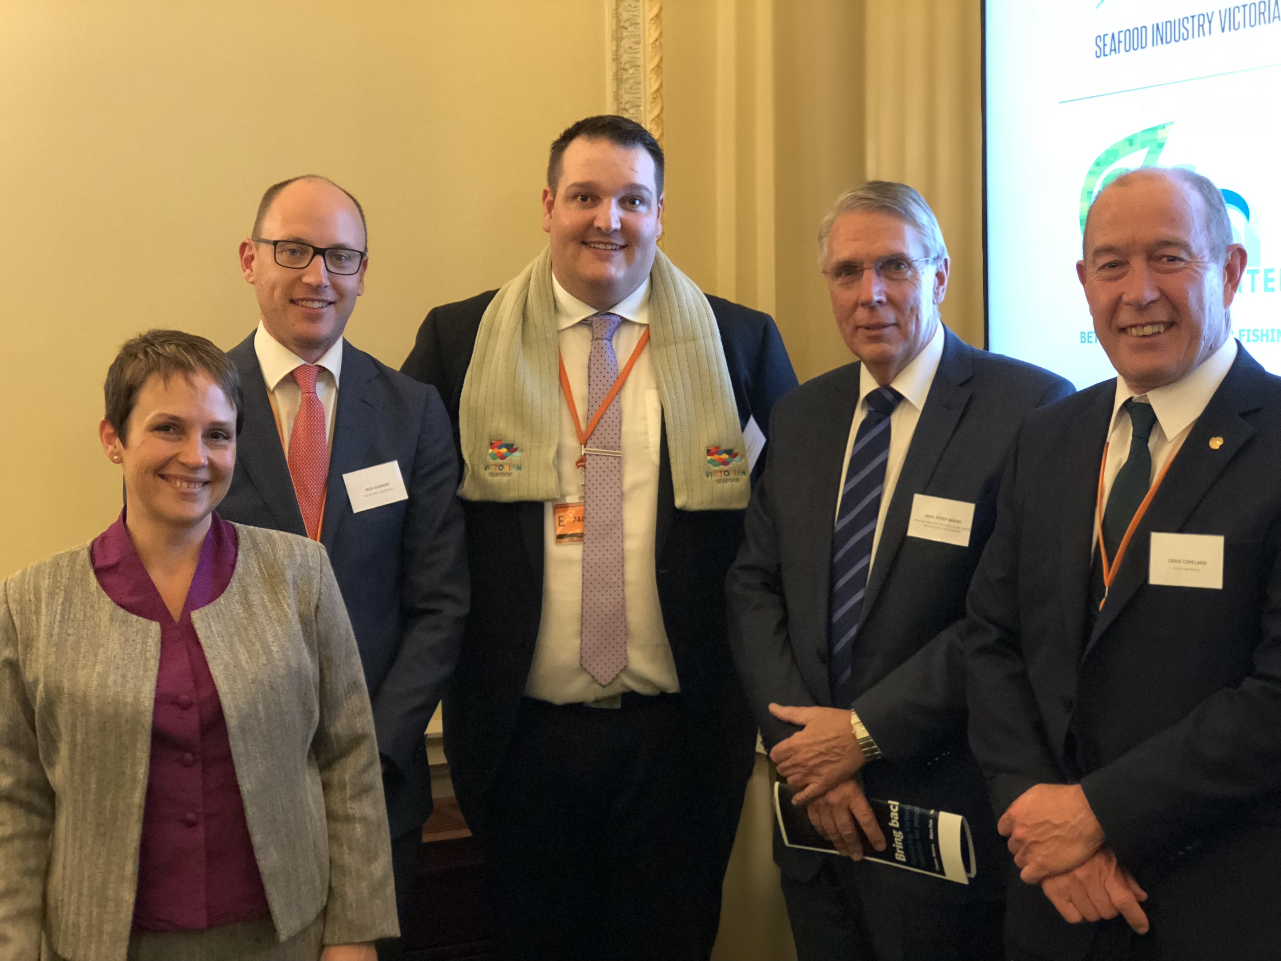
The Victorian Seafood Experience
Victorian Parliament House Seafood Event

Slide 8
Industry Benefit:
Faces of the industry are recognised, understood and respected
  Social License delivered!
Increased trade for aligned organisations (restaurants, hotels, etc)
Increased profitability for industry
Joining the tourism growth market and sharing value of seafood sales year round…
Notes:
The people, the Places and the Product of the Victorian seafood industry are recognized, understood and respected… Delivering a social license for industry – great news!
Customers get to experience local seafood in a local place
Customers develop an understanding of local produce and industries (including seafood)
Increased trade opportunities, increased consumer demand = greater demand for Victorian produce in local markets.
New avenues through which produce can be marketed and sold = increased productivity
Joining the tourism growth market and sharing value of seafood sales year round… - not just as a celebratory item…

Slide 9
To Date:
Festival engagement
Collateral (banners, stress balls,
t-shirts, hats, etc…)
“Victorian Seafood SOLD HERE” posters, light distribution
Industry engagement growing
New members
Actively engaging and leading festivals and events
Industry United
Program funded by SIV…
Trademark underway

Slide 10
The Future:
Continue to:
  Showcase the people, products and places of the Victorian Seafood Industry
  Increase public awareness of the industry and its contributions (social, economic, health, environment, tourism & hospitality, etc.)
  Create destinations and experiences whereby seafood becomes core to the experience of place
  Shape the interaction between consumer and product in multiple contexts including supermarkets, restaurants, Fish & Chip shops, etc. and through various media
Notes:
Showcase the people, the places and the product - through targeted messaging and a focused program of events and activities
Increase public awareness of the industry and its contributions (social, economic, health, environment, tourism & hospitality, etc.) – most of us probably worked through this in SIA’s ‘pledge’ yesterday… so important!

Slide 11

The Future:
All of this requires $$$
  Continue to seek State Government support
  Identifying opportunities for Grant funds (where possible) to support the program
  Continue to build industry ownership, support and subsequent funding

Slide 12
Johnathon Davey
Thank you!
johnd@siv.com.au
0407032023

Slide 13
