Slide 1
Be CoOL and Our Pledge
Jane Lovell
CEO, Seafood Industry Australia

Slide 2
Our Pledge

Slide 3
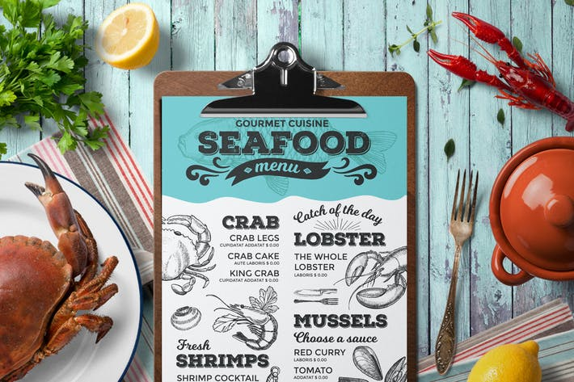
Be CoOL

